Slide 1



Ionic PMJ
01 Pemula Ionic Capacitor
bit.ly/fstmkuis

Slide 2
Ionic PMJ
02 Ubahsuai Projek Ionic
dengan input HTML

Slide 3
Ionic PMJ
03 Borang input Angular
& TypeScript

Slide 4
Ionic PMJ
04 Pilihan (if...else), Tatasusunan Gelung (Array Loop), Typescript/Angular

Slide 5
Ionic PMJ
06 Set tetapan
firebase dalam Ionic

Slide 6
Ionic PMJ
07 Carian dari Ionic
ke Firestore

Slide 7

Schedule
Day1: Intro to Ionic, HTML Angular,
Tabs, Cards Layout, Buttons, Labels, Inputs
TypeScript: pembolehubah, sintaks
If..else in typescript & angular
Repetition
Functions in Typescript
Page navigation
Day2: Online database with Firebase

Slide 8
OVERVIEW
TO IONIC FRAMEWORK

Slide 9
What is Ionic?
Ionic Framework is an open source UI toolkit for building performant, high-quality mobile and desktop apps using web technologies (HTML, CSS, and JavaScript).

Slide 10
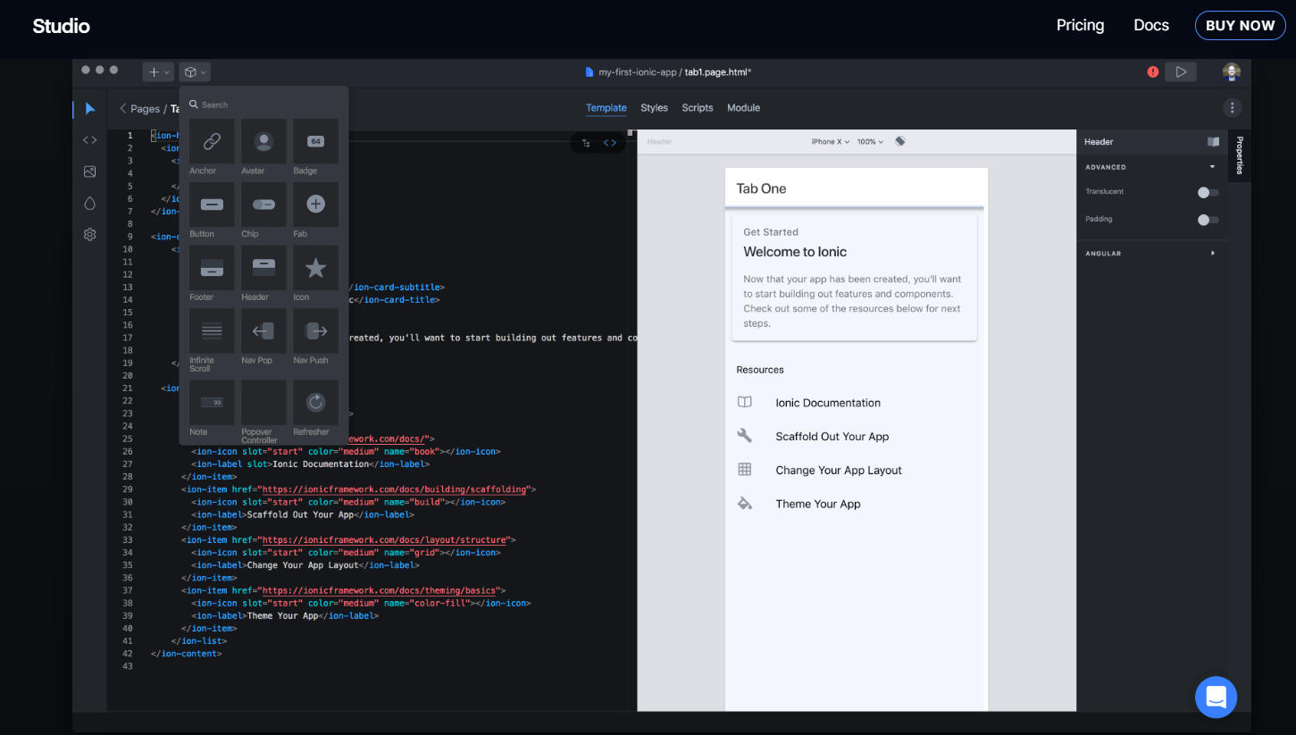
IonicX

Slide 11
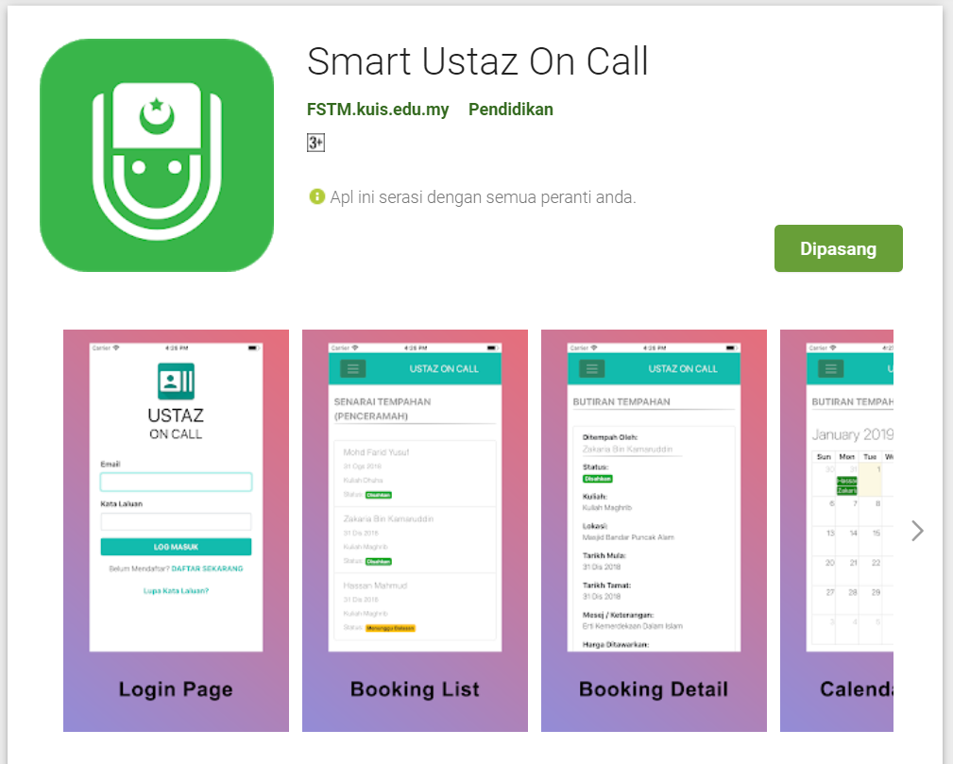
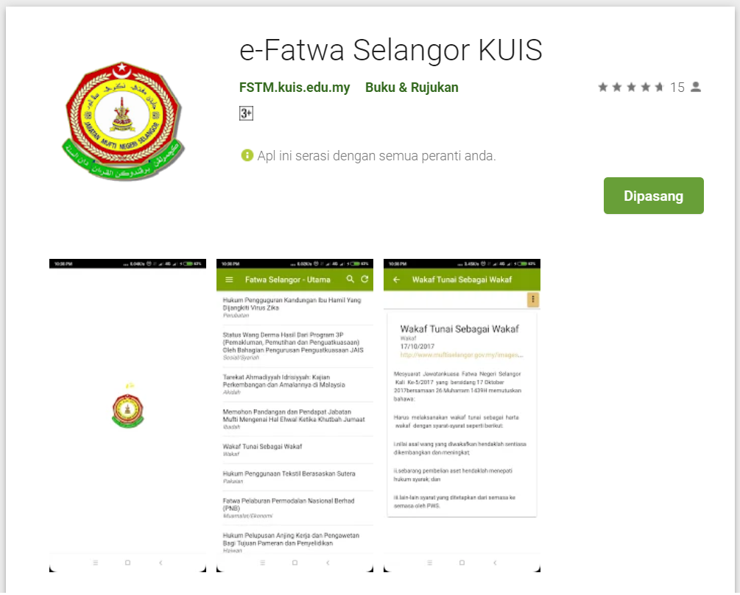
Available apps

Slide 12
IOS & Android Software Development
In a nutshell

Slide 13





Android Studio
(Java & Kotlin)
Android Device
NATIVE - 2 X WORK
XCode (Swift & Objective C)
iPhone/iPad

Slide 14

1 x WORK
Compile with Android SDK
Android Device
Cordova + Capacitor
Hybrid
XCode Project
iPhone/iPad

Slide 15
Cordova
Framework
Hybrid
WEB LAYER
NATIVE APP

Slide 16
1 x WORK
Build Progressive Web Apps
Android Device
Build Progressive Web Apps
Cordova
Framework
Hybrid
iPhone/iPad

Slide 17


1 x WORK
Android Studio
Android Device
+
XCode
iPhone/iPad

Slide 18
https://capacitor.ionicframework.com/

Slide 19



WHY IONIC?
Framework specifically to develop apps
Multiple platforms-Android, IOS, Windows, Amazon etc
Apps development using HTML & Typescript (subset of Javascript)
Plugins (camera, thumbprint, bluetooth, printer etc etc etc)

Slide 20
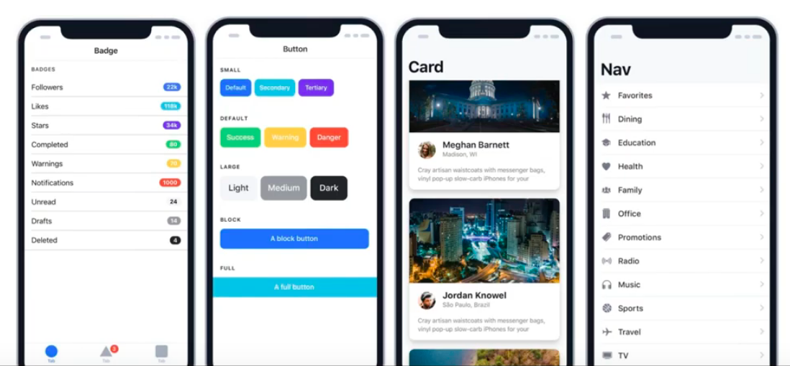
WHY IONIC?
Large COMMUNITY for support
Pre built gestures & animation
100+ UI Components
Everything is OPEN SOURCE
Built with Ionic

Slide 21
Software to start Ionic?

Slide 22
What do you need?
To run IONIC:
Node Package Manager (NPM)
Ionic Cordova Framework
Google Chrome Web Browser
To develop/publish app
VSCode OR any other IDE (with Typescript Plugin)
Ionic Capacitor
Android SDK or Xcode - can be done later

Slide 23

Download from nodejs.org
Download and install the NODEJS LTS version 14
http://nodejs.org

Slide 24
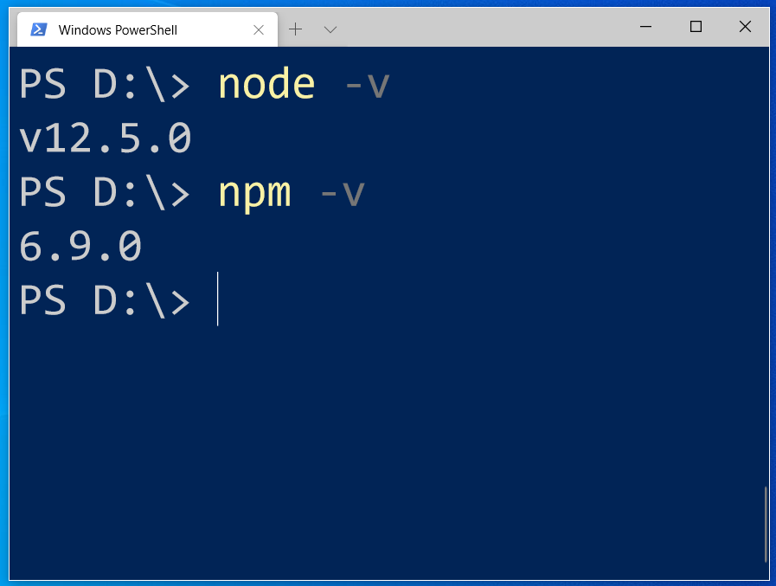
After install NodeJS from nodejs.org
node -v
npm -v

Slide 25
2. From command terminal run:
npm install -g @ionic/cli

Slide 26
Now, let’s install the tools

Slide 27
Install VSCode/sublime
NodeJS
Tutorial is here bit.ly/ionickerul
Install Google Chrome Browser
(If you don’t have, you should)

Slide 28
Before we start coding, some basic stuff...

Slide 29
-HTML?
-CSS ?
-TypeScript ?

Slide 30
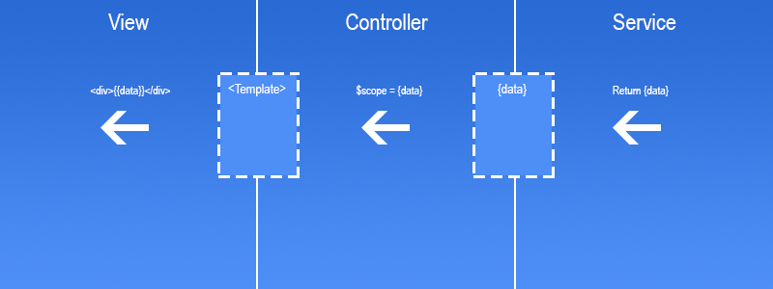
Simple MVC in Ionic
.HTML | .TS | services .TS /Model

Slide 31
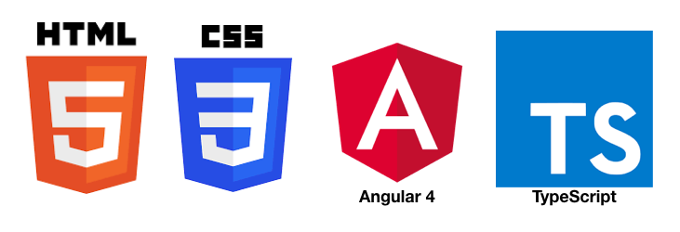
HTML
-Hyper Text Mark Up Language (HTML)
-Used to display the interface
-Write in tags,
-Example- <strong>Hello</strong> → Hello
-Ionic has its own built in tags
<ion-list></ion-list>
<ion-item></ion-item>
<ion-grid></ion-grid>
-HTML in Ionic is “AngularJS Flavoured”
-Have to use Angular Syntax for data and clicks
-Example- (click), *ngFor etc

Slide 32
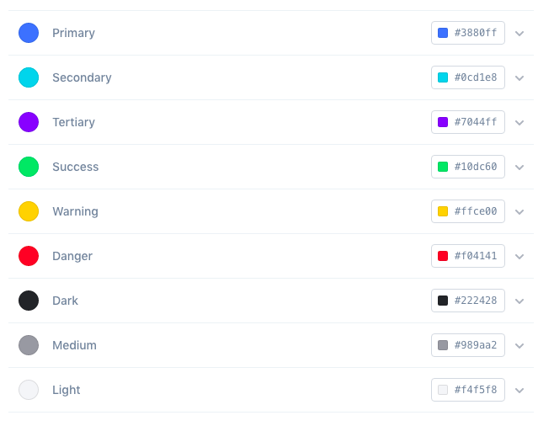
CSS or SCSS
-Cascading Style Sheets (CSS)
-Used for styling, very straightforward
-Each generated Ionic page comes with built in own CSS
-Can assist in ‘theming’ the app
-Ionic has standard built in colours
-Primary, Secondary, Danger, Light & Dark
Built in colours that can be added/edited

Slide 33
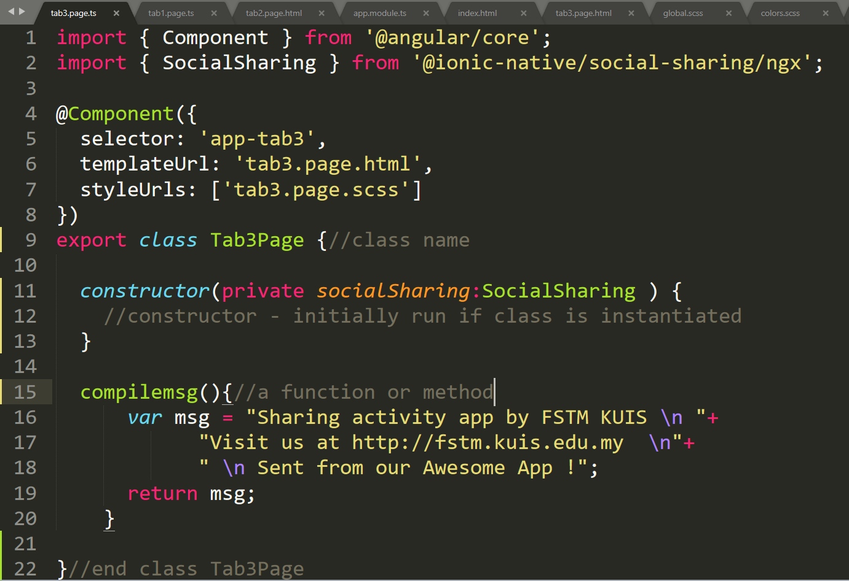
Class Function

Slide 34
Hello World ionic

Slide 35
1. Start a project
ionic start ionpmj tabs

Slide 36
2. CD into Directory & Run the project
ionic serve

Slide 37
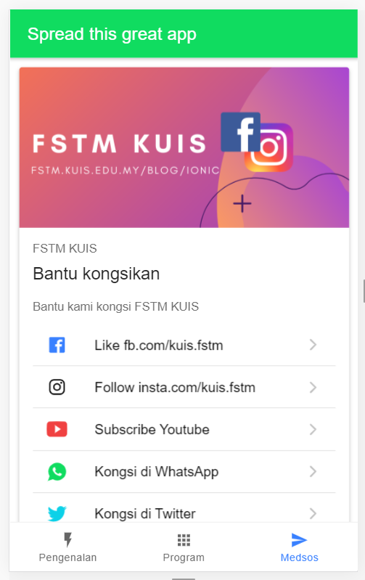

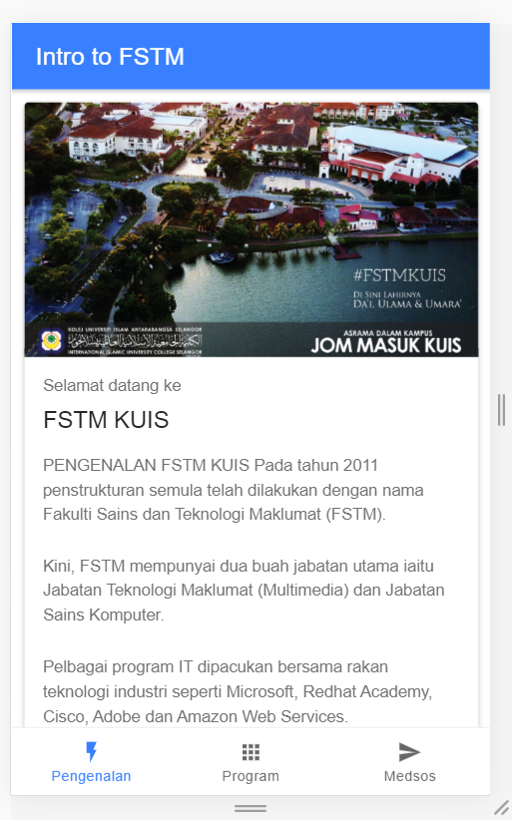
Next tab2 and tab3

Slide 38


T02 HTML interface
(antaramuka)

Slide 39
T02 Antaramuka
HTML
(sambungan bahagian2)

Slide 40
1. Start a project
ionic start appfstm tabs

Slide 41
2. CD into Directory & Run the project
ionic serve

Slide 42
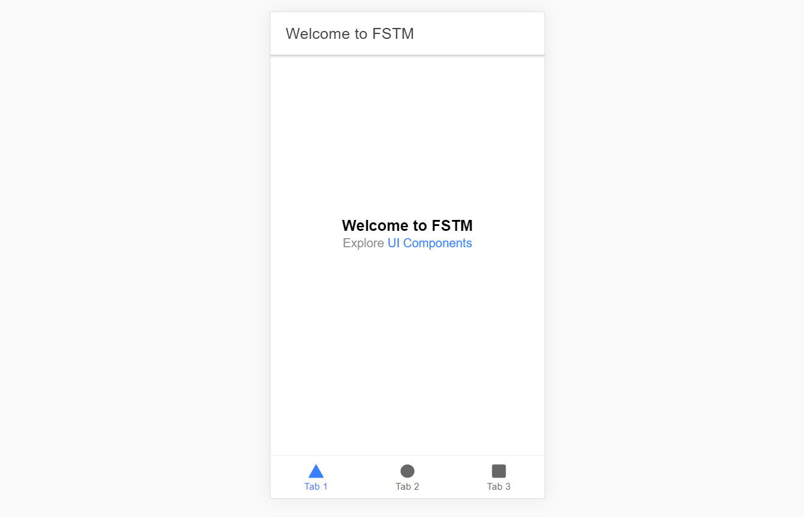
Output : ionic serve

Slide 43
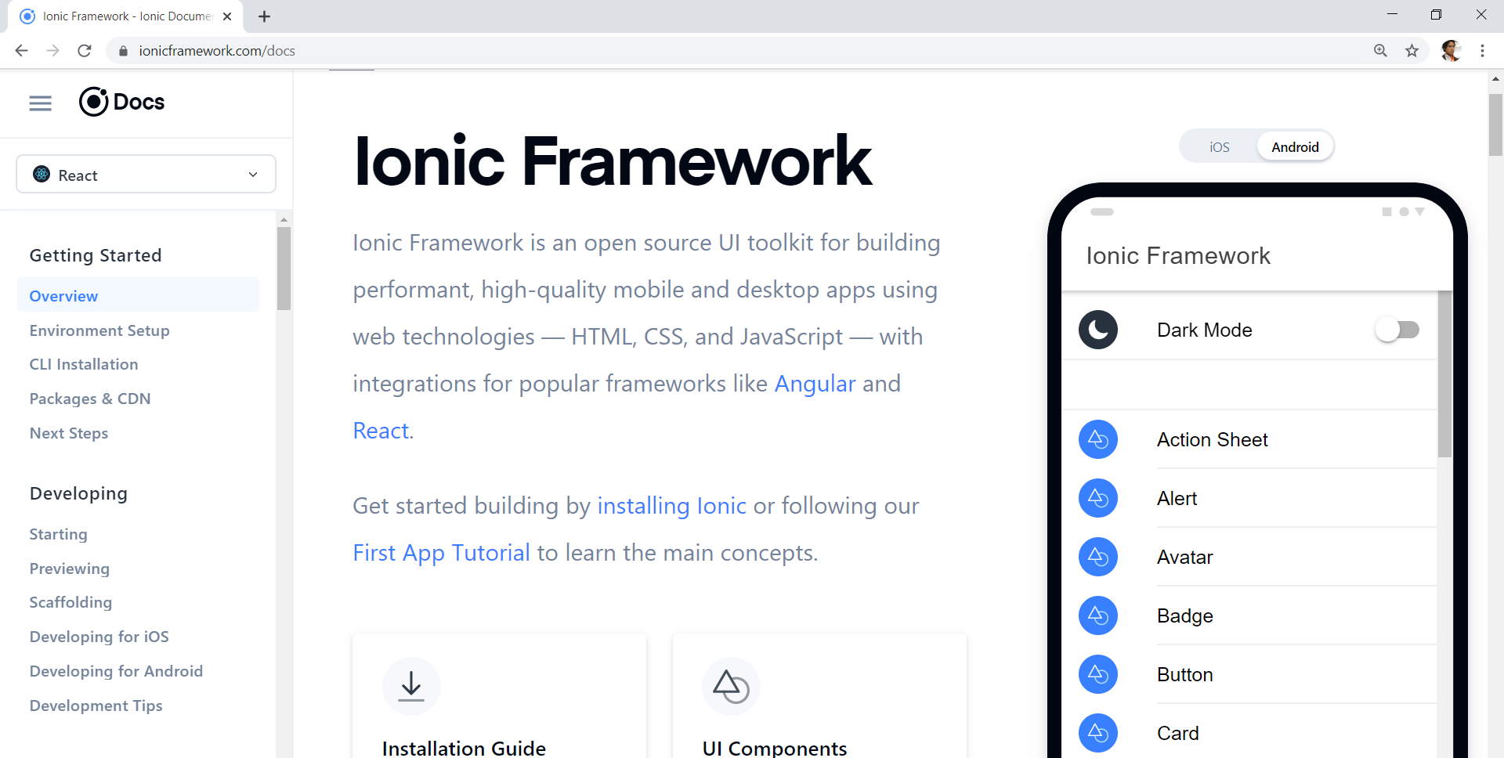
Always refer to documentations: https://ionicframework.com/docs

Slide 44
HTML
-Hyper Text Mark Up Language (HTML)
-Used to display the interface
-Write in tags,
-Example- <strong>Hello</strong> → Hello
-Ionic has its own built in tags
<ion-list></ion-list>
<ion-item></ion-item>
<ion-grid></ion-grid>
-HTML in Ionic is “AngularJS Flavoured”
-Have to use Angular Syntax for data and clicks
-Example- (click), *ngFor etc

Slide 45
CSS or SCSS
-Cascading Style Sheets (CSS)
-Used for styling, very straightforward
-Each generated Ionic page comes with built in own CSS
-Can assist in ‘theming’ the app
-Ionic has standard built in colours
-Primary, Secondary, Danger, Light & Dark
Built in colours that can be added/edited

Slide 46
Next tab2 and tab3

Slide 47
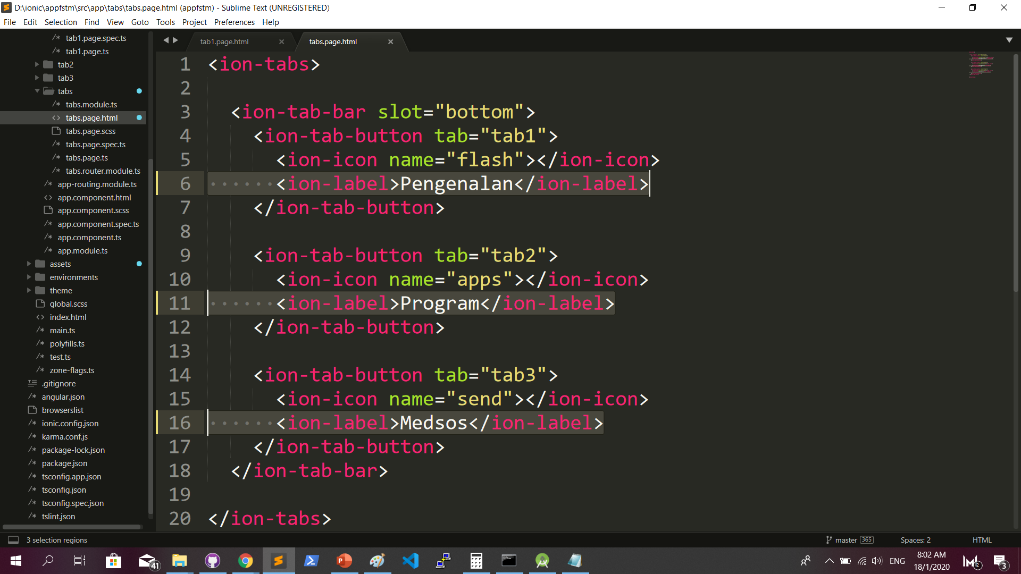
Some interface cosmetics: src/app/tabs/tabs.page.html

Slide 48
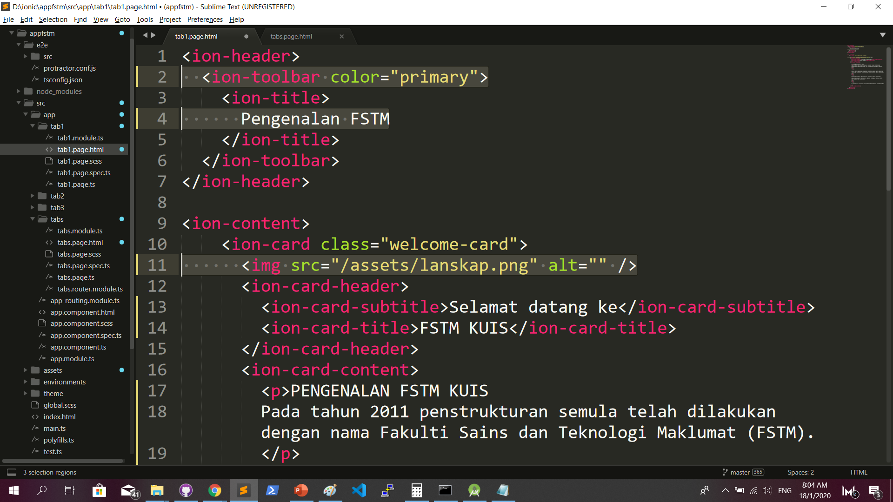
More interface cosmetics: src/app/tab1/tab1.page.html

Slide 49
Run ionic serve

Slide 50
Next tab2 and tab3

Slide 51
Codes & slides github.com/khirulnizam/ionic5

Slide 52
T03 Navigasi
(page navigation)

Slide 53
Page Navigation
+ routerLink (in .html) + NavController (in .ts)

Slide 54
routerLink in HTML
PAGE 1
PAGE 2
See app-routing.module.ts for page name

Slide 55
Exercise : Link to new page
Generate new pages
ionic g page info
ionic g page form

Slide 56
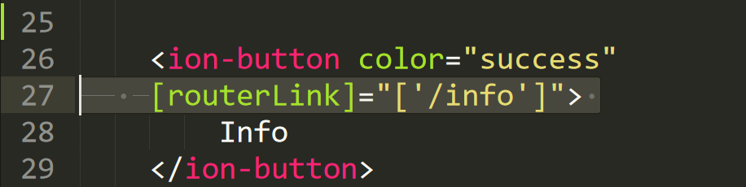
Exercise : Link to new page

Slide 57
NavController in TS
PAGE 1
PAGE 2
See app-routing.module.ts for page name

Slide 58
Add simple form interaction
+ Form Button + Alert function

Slide 59
Try building a button and make an alert
helloWorld(){
alert(“Hello Ionic!”)
}
<ion-button (click)=”helloWorld()”> ALERT </ion-button>
info.page.ts
info.page.html

Slide 60

Codes & slides github.com/khirulnizam/ionic5

Slide 61

T04 TypeScript

Slide 62
TypeScript
-A subset of Javascript
-Part of ECMA6 standard
-The ‘brains’ behind your app
-Used for processing & handling data
Example- calculation, accessing DB etc
-Ionic has standard built in to its TS:
NavController, ModalController etc

Slide 63
Typescript Syntax : Function
n1:number;
n2:number;
output:any;
addnumbers(){
output=n1+n2;
displayresult( );
}
displayresult( ){
alert(“Output: ”+output);
}

Slide 64
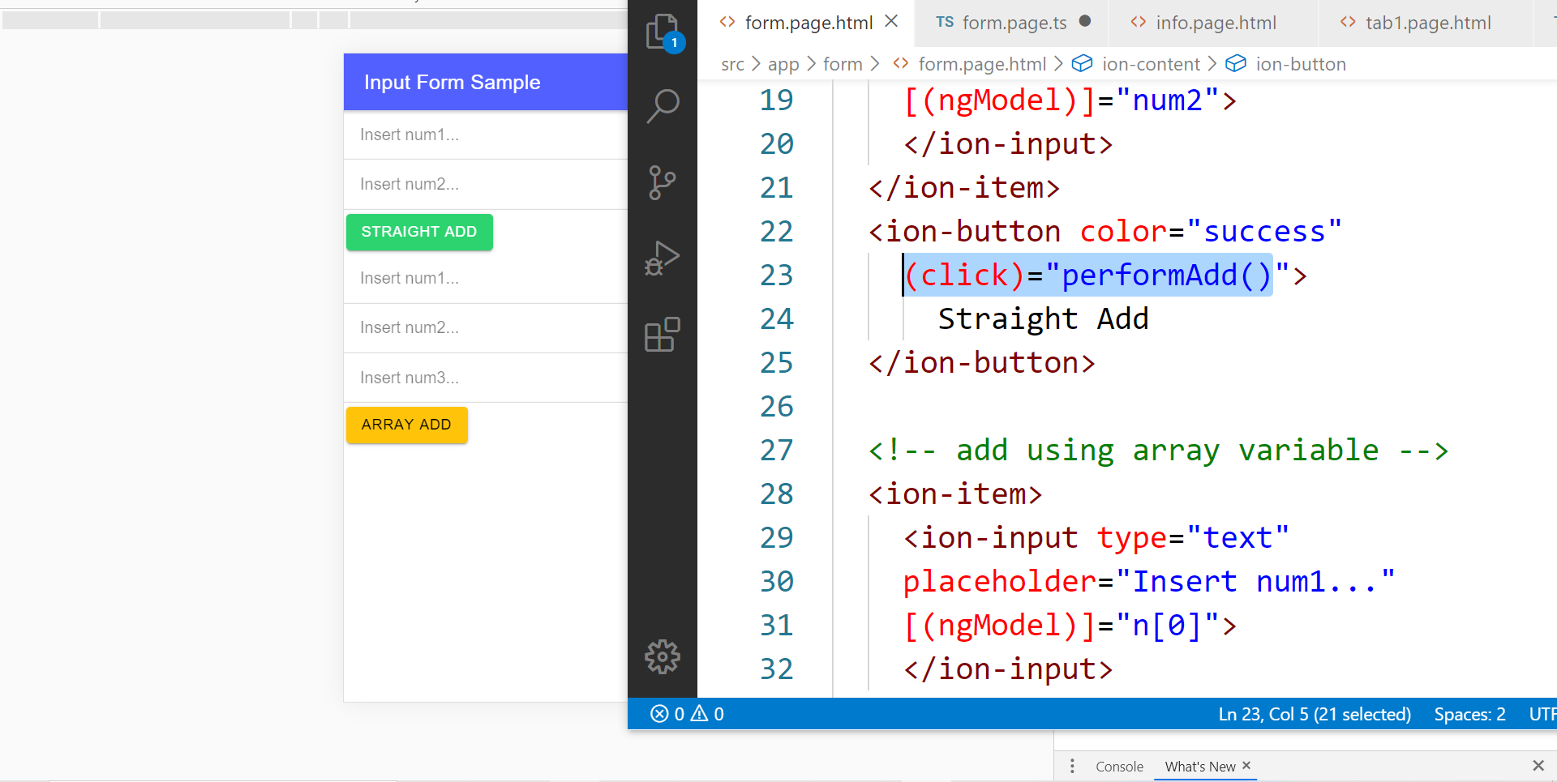
In file .HTML

Slide 65
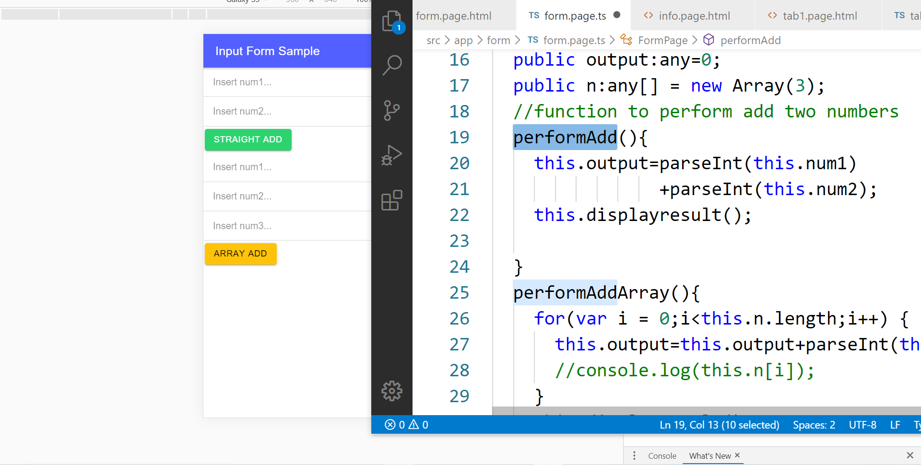
In file .TS

Slide 66
TypeScript Syntax : EX1 variable
What is a variable?
A variable acts as a container for values in a programming code.
var pi:number = 3.14;
Var num1:number=5;
var name:string =“enKerul”;
Use any to loosely-type the variable data type.
Data types:
any
can be numbers or strings
string
“this is string ” + “ concat ”
number
Double 3.14, or integer 5
array
can be a collection of Var, Strings or Objects

Slide 67
Typescript Syntax : EX2 String manipulation & Casting
//to convert String to number
var str = "54";
//easy way by using + operator
var num = +str; var num = parseInt(str);
String manipulation?
var str:string = "3.14";
var pi:number = 3.14;
console.log("pi is "+pi);
console.log("tau is "+(2 * pi));

Slide 68
Typescript Syntax : EX3 Array
Array? Array
can be a collection of Var, Strings or Objects
// A list literal.
var numbers = [4, 1, 5, 6, 3, 2];
for(var i=0;i<numbers.length; i++)
{
sum=sum+numbers[i]);
console.log(“Sum: ”+sum);
}
-----
Output
Sum: 21

Slide 69
Typescript Syntax : EX4 Associative array
Associative Array?
Array with key and value pairs (not index number).
// A map literal.
// Asociative array
var gases = [
'He': 'Helium',
'Ne': 'Neon',
'Ar': 'Argon’,
];
console.log(gases['Ne’]);
-------------------------
Output: Neon

Slide 70



T05 Kamera (installing camera plug-ins)

Slide 71
Codes & slides github.com/khirulnizam/ionic5

Slide 72
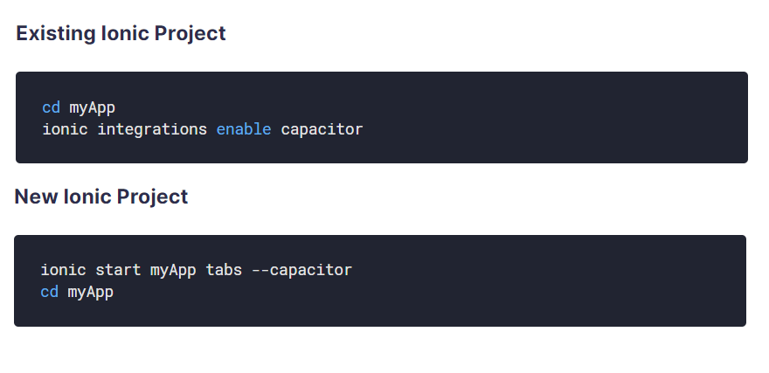
Using Capacitor with Ionic

Slide 73
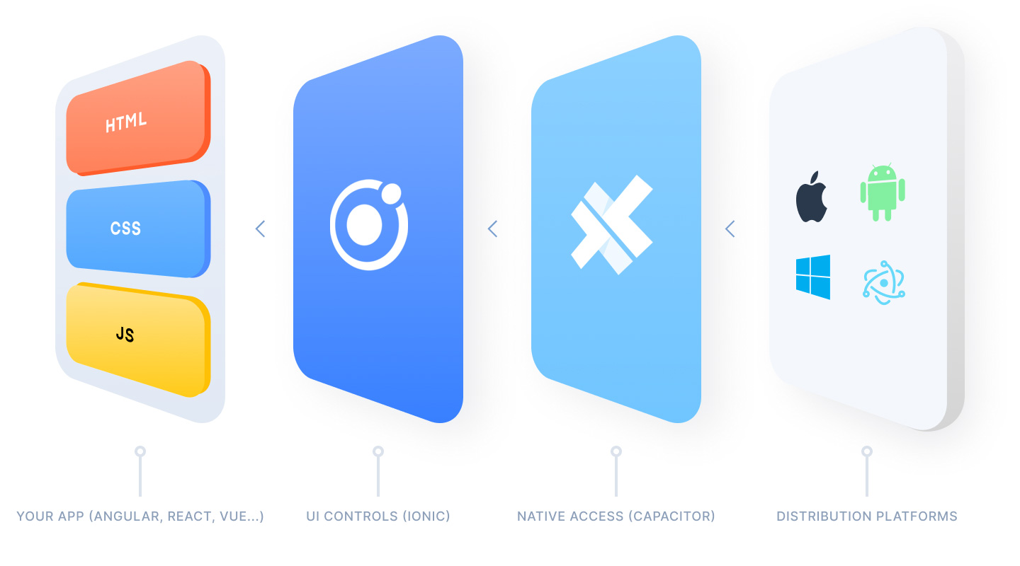
Ionic Capacitor
https://ionicframework.com/resources/articles/capacitor-vs-cordova-modern-hybrid-app-development
runs modern Web Apps natively on iOS, Android, Electron, and Web

Slide 74
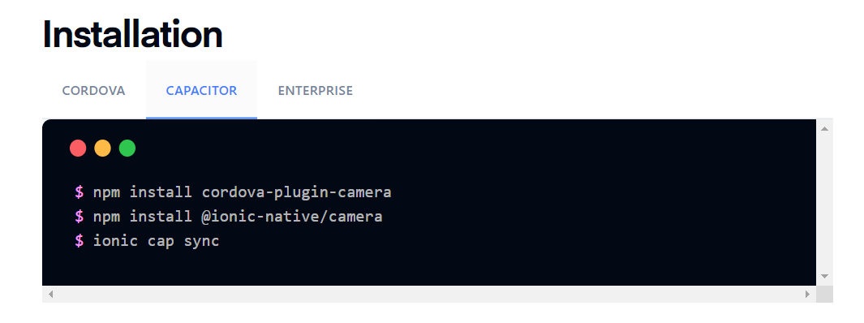
Install camera support : ionicframework.com/docs/native/camera

Slide 75
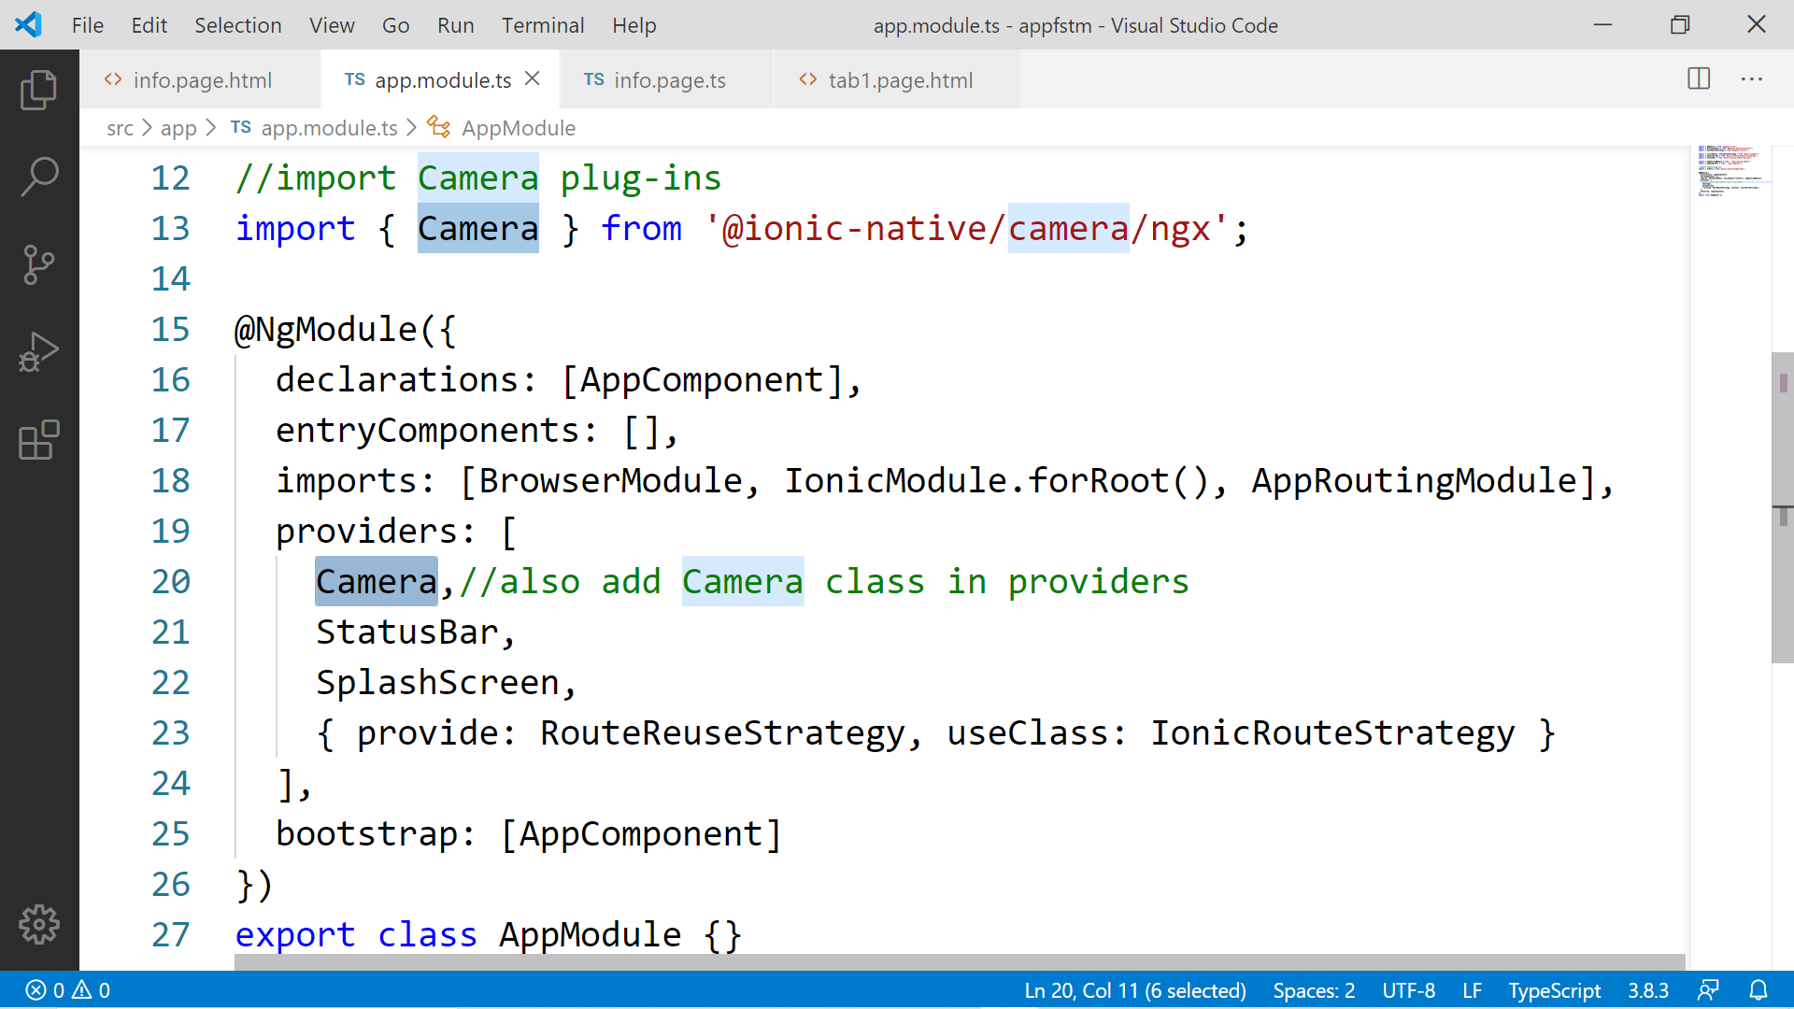

Slide 76
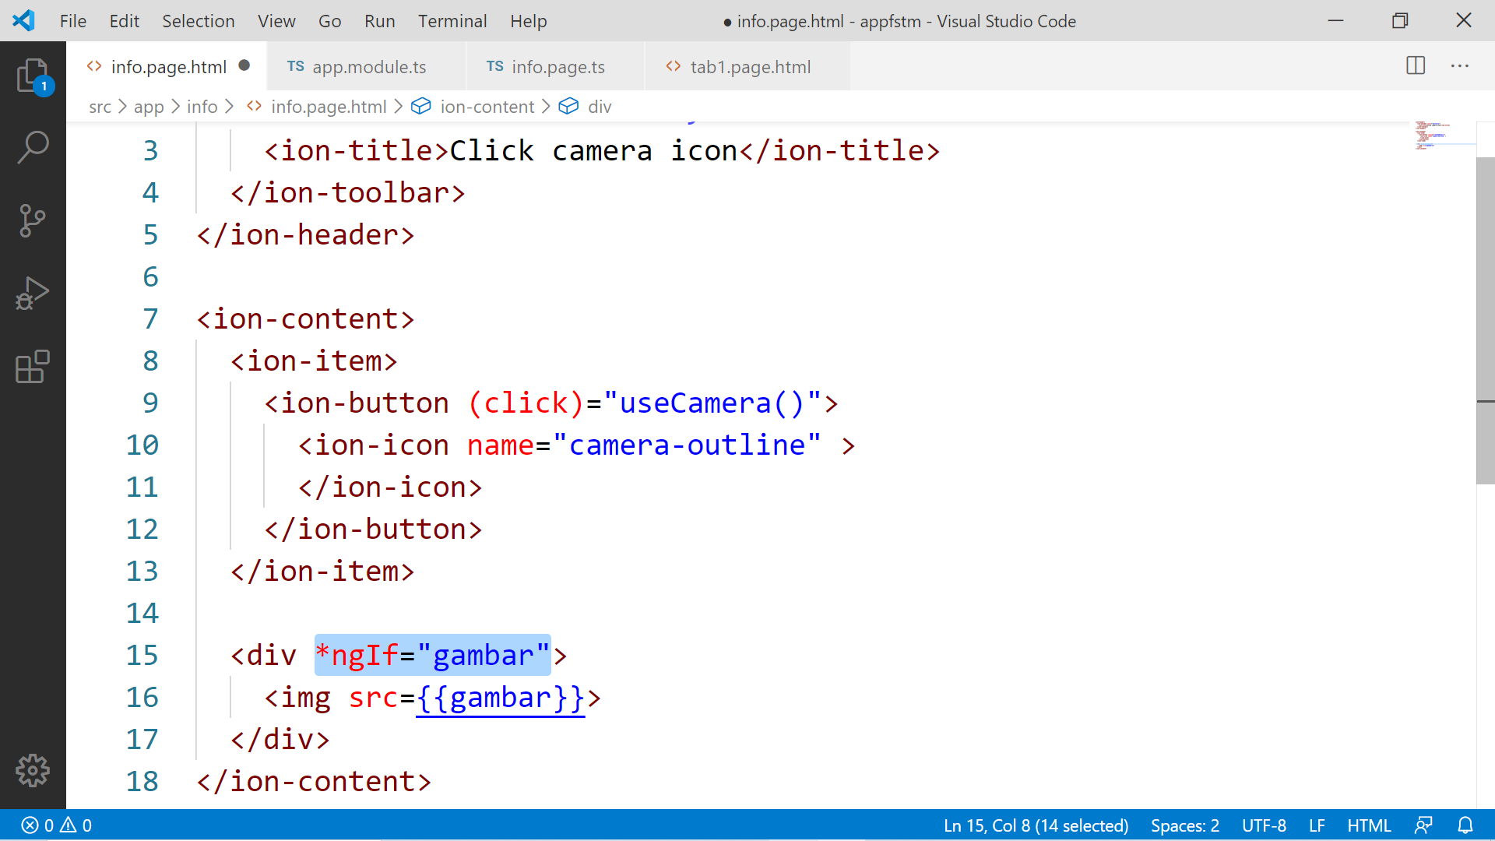

Slide 77
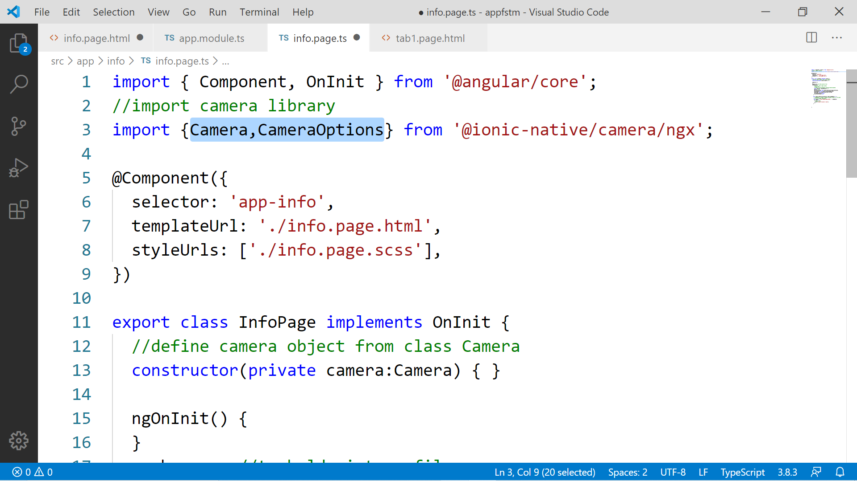

Slide 78
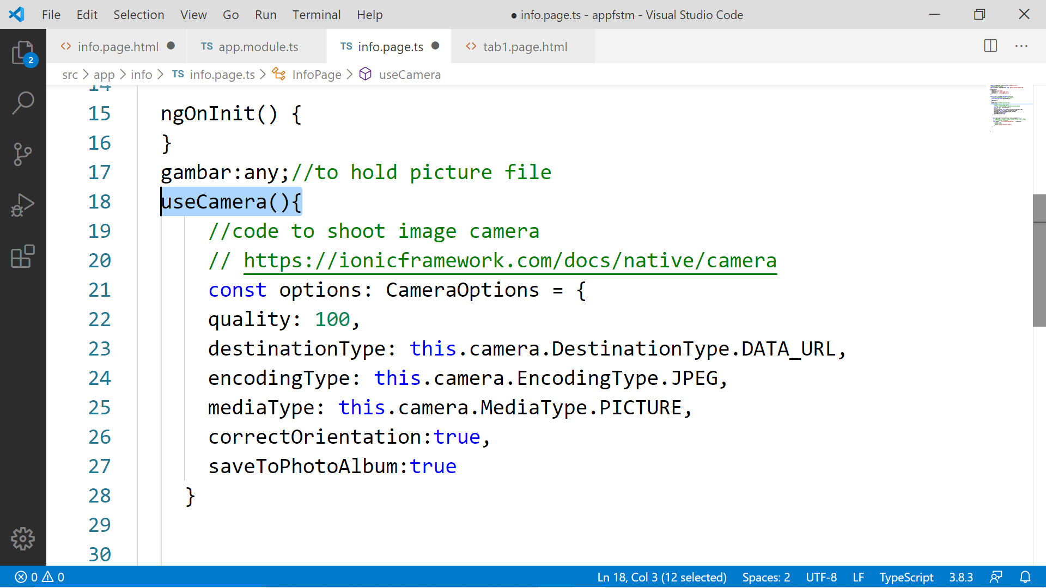

Slide 79
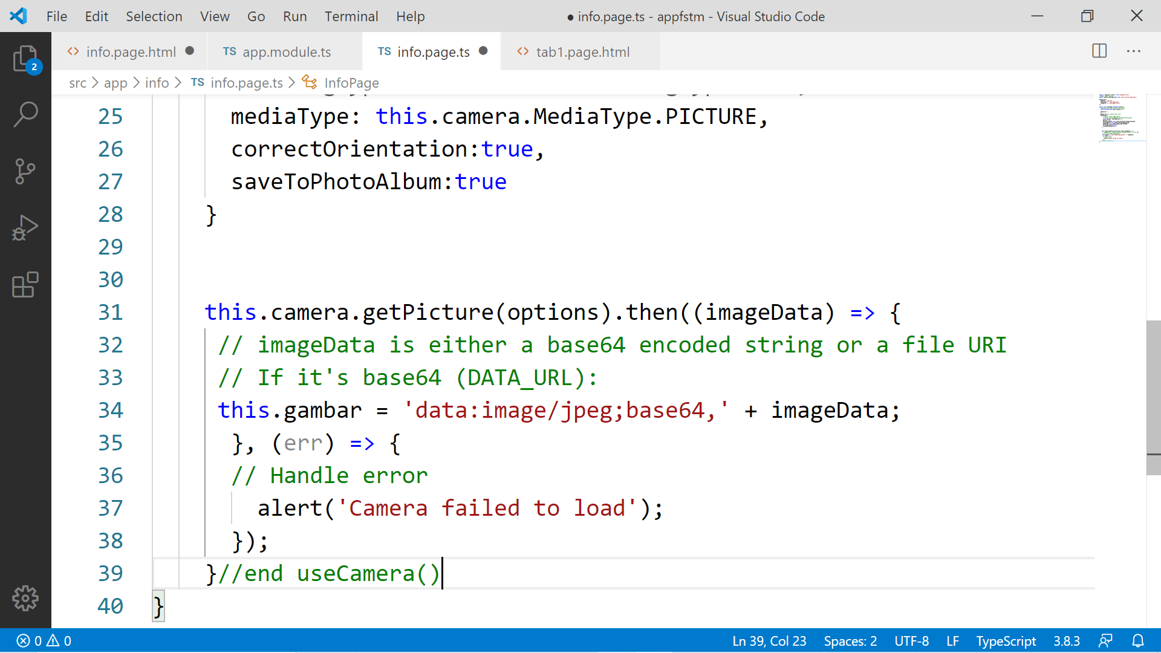

Slide 80
Migration Cordova to Capacitor - error: package android.support.v4.content does not exist
npm install jetifier
npx jetifier
npx cap sync android

Slide 81
Ionic Capacitor
https://ionicframework.com/resources/articles/capacitor-vs-cordova-modern-hybrid-app-development
runs modern Web Apps natively on iOS, Android, Electron, and Web

Slide 82
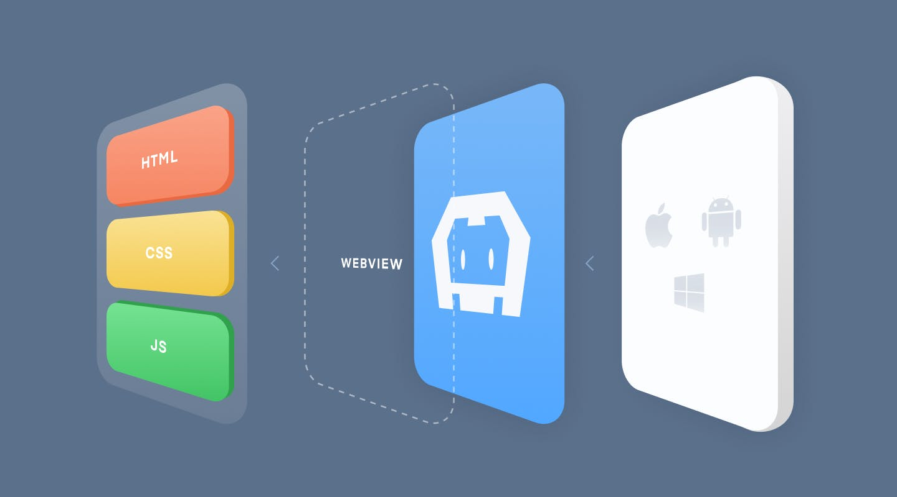
Previously we have CORDOVA

Slide 83
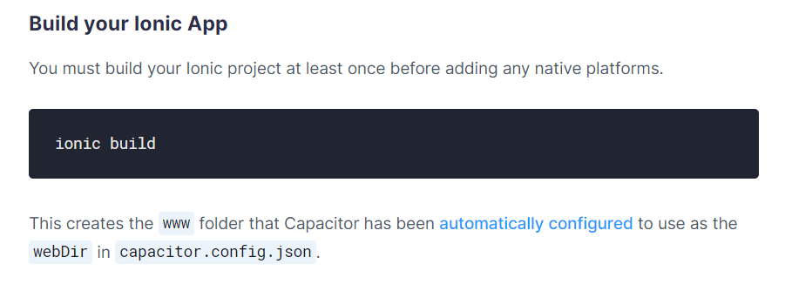
Ionic build

Slide 84
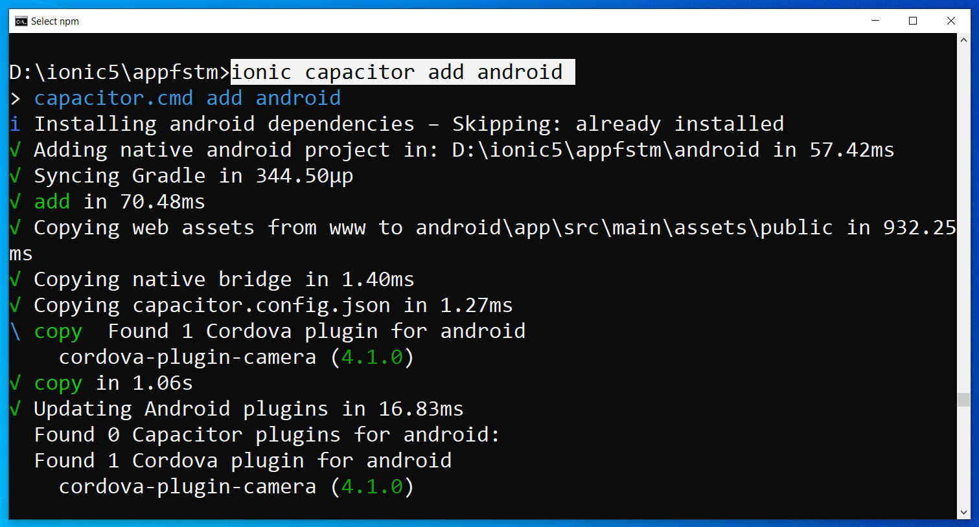
Run only once for each ionic project
To update Android project, execute
ionic build
npx cap copy

Slide 85
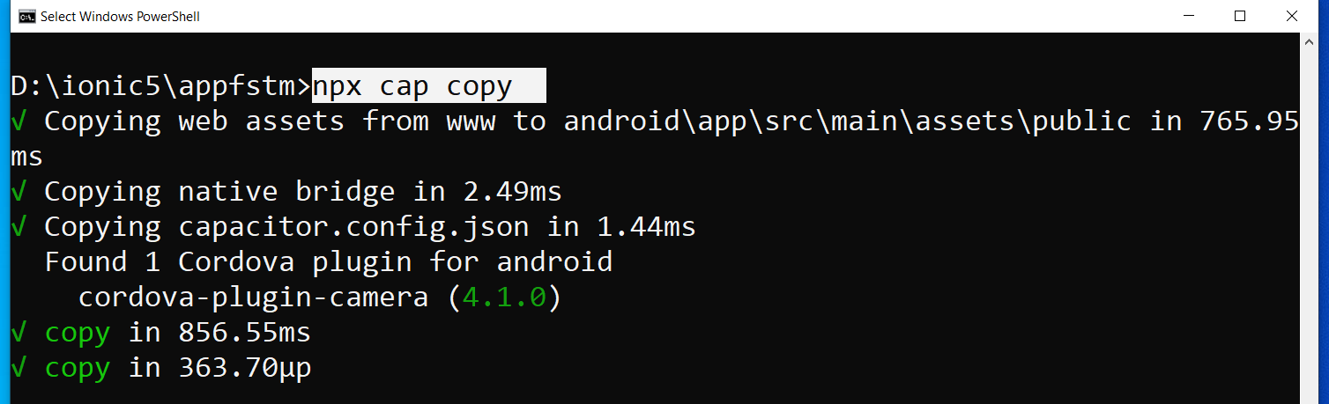
After finish installing the camera plug-ins

Slide 86
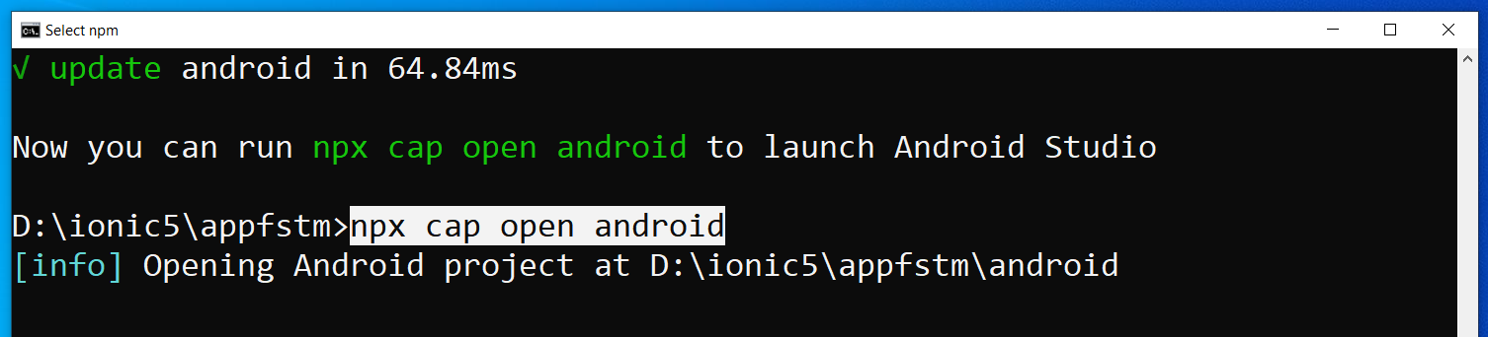
To open project on Android Studio

Slide 87
Codes & slides github.com/khirulnizam/ionic5

Slide 88
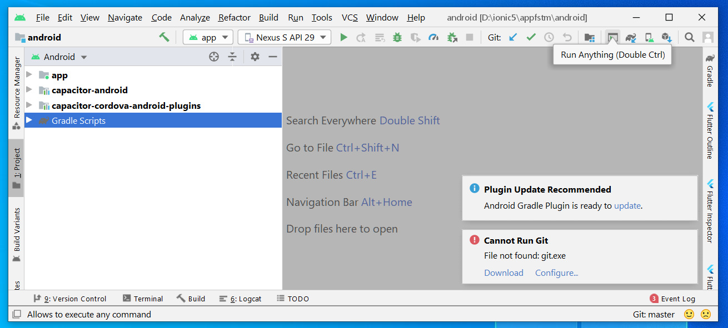
Open in Android Studio

Slide 89
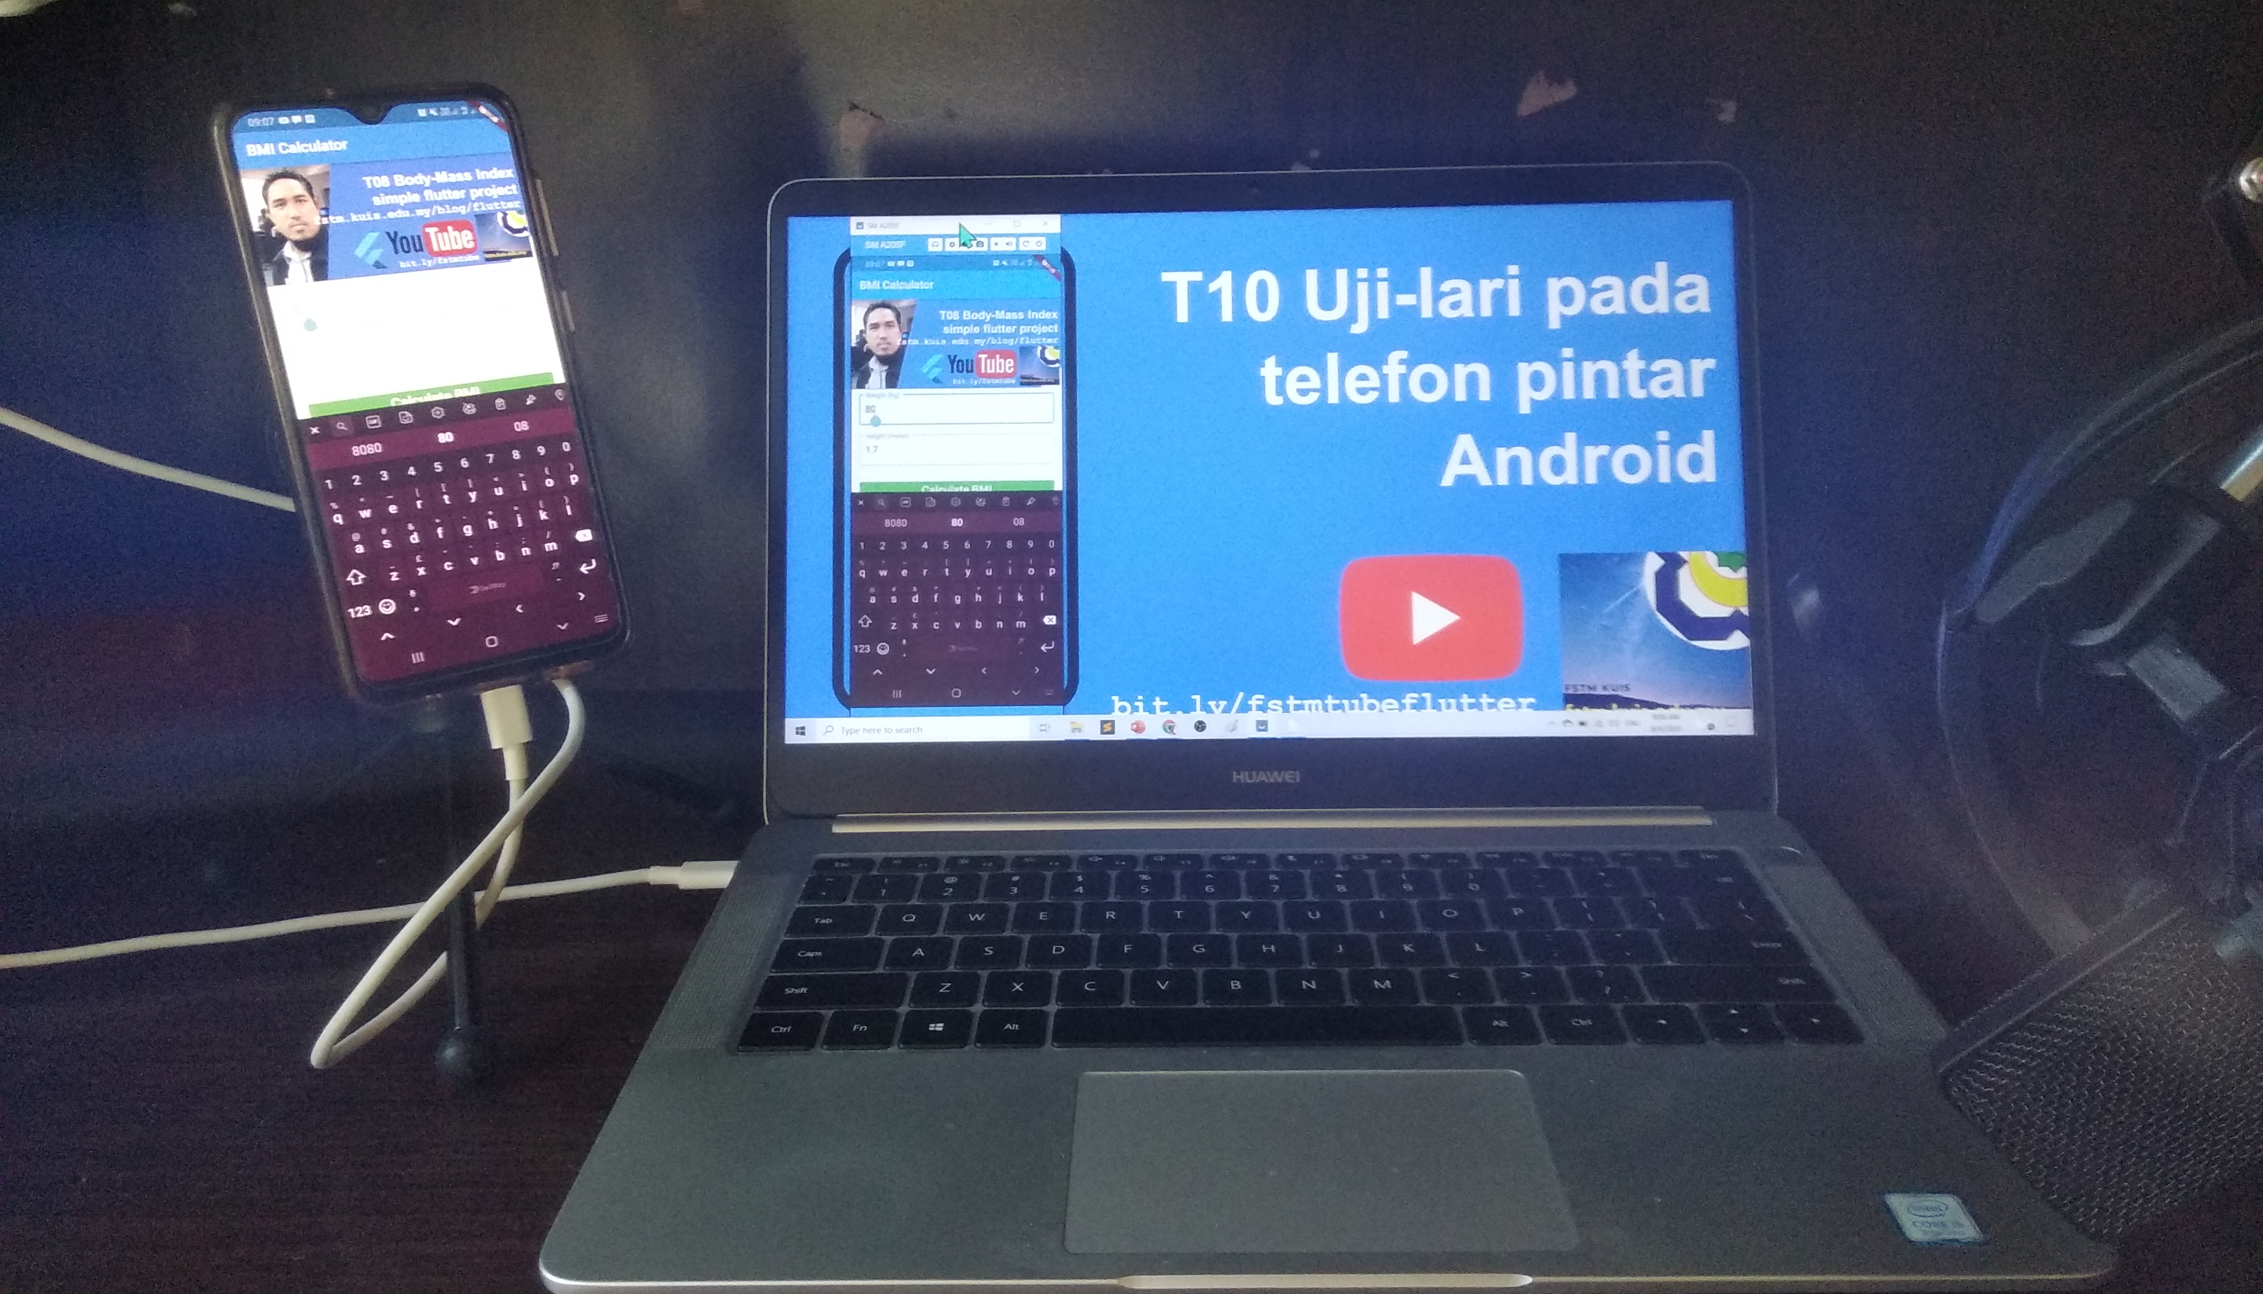


Uji-lari
apps pada
telefon
Android

Slide 90

Android Studio 3.6 & SDK developer.android.com/studio

Slide 91
Path settings (environment variables)
ANDROID_SDK_ROOT
JAVA_HOME

Slide 92
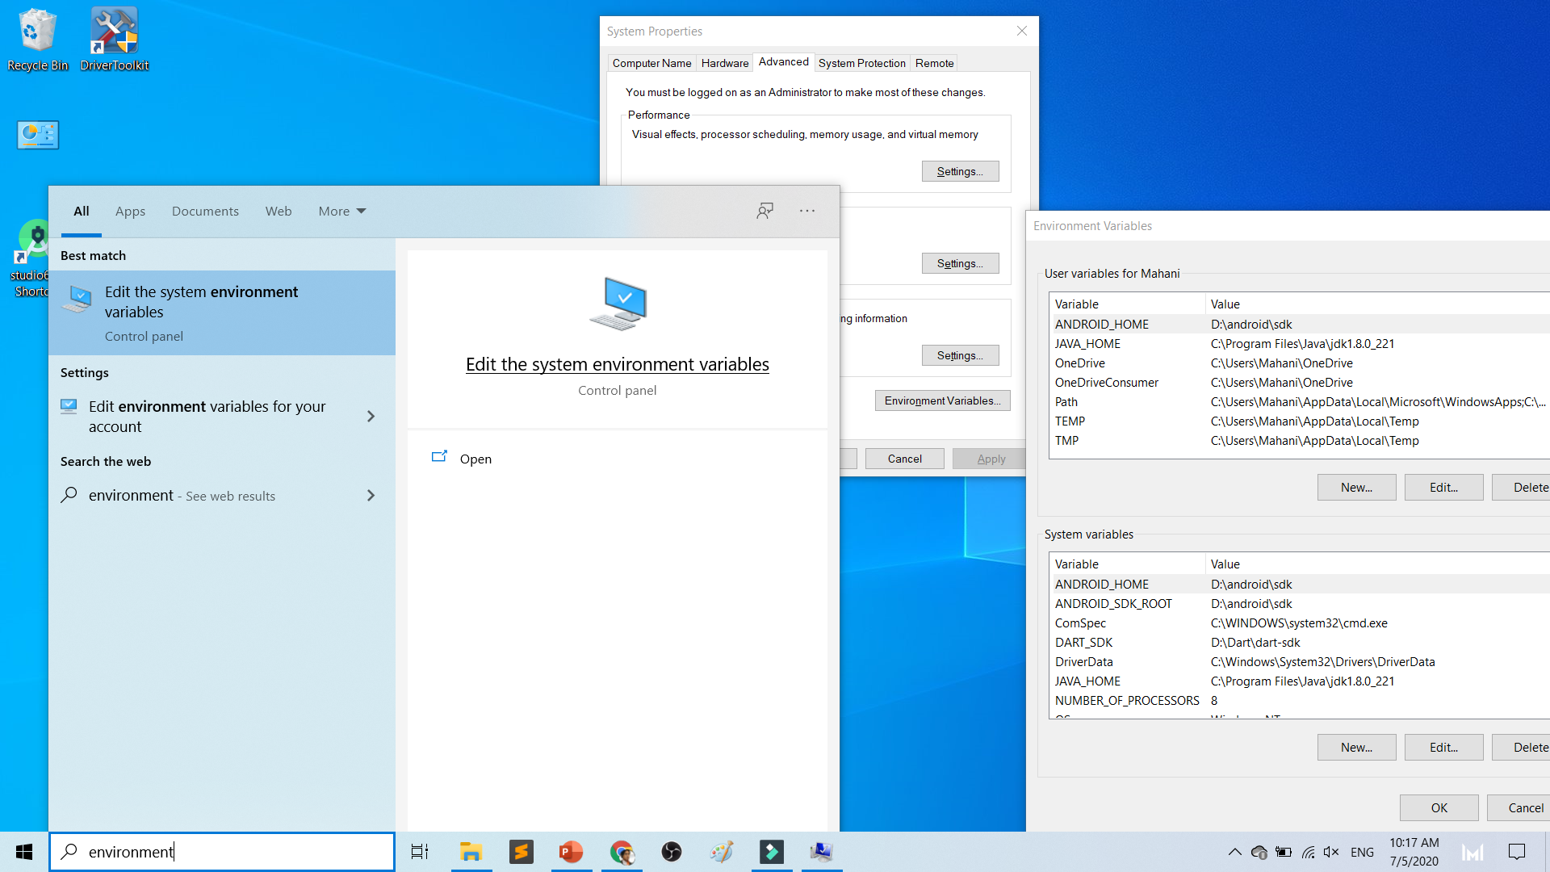

Slide 93
To deploy
Android Studio
Android SDK
Android Phone with USB Debugging enabled
ADB Bridge
USB Data-cable for Actual Device

Slide 94
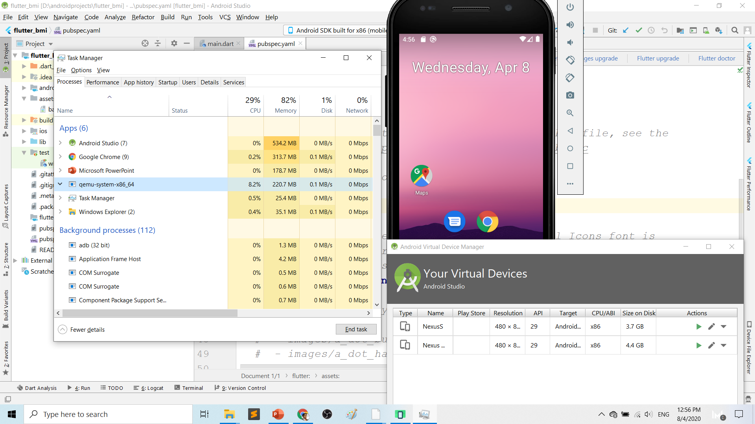
Play.google.com
What’s wrong with Android Studio & Emulator? RESOURCE-HUNGER

Slide 95
Requirements 1. USB debugging ON- phone 2. Connect USB Cable 3. Install ADB driver in PC

Slide 96
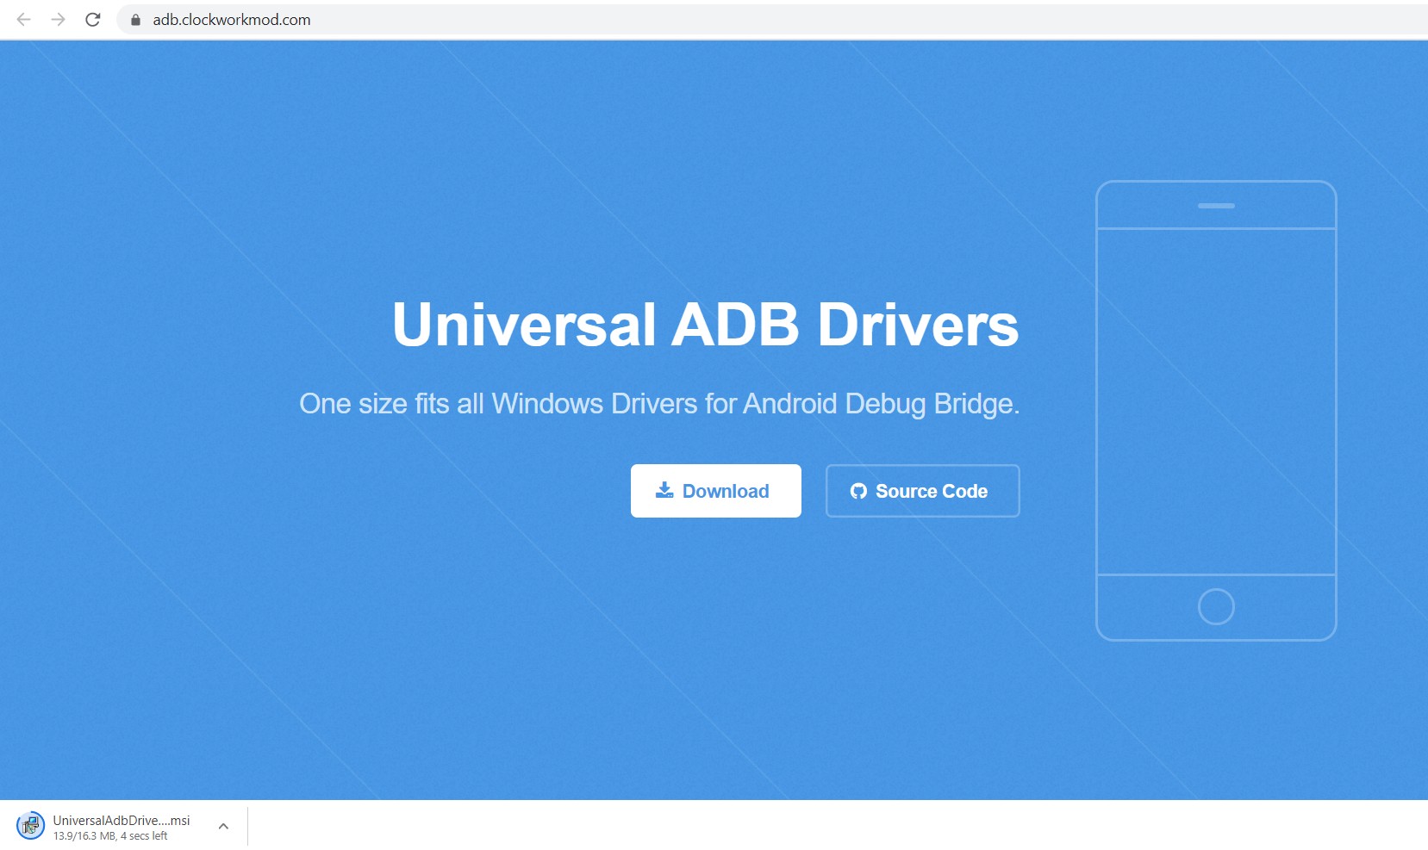
Play.google.com
Install universal debug driver
https://adb.clockworkmod.com/
Download & install universal debug

Slide 97
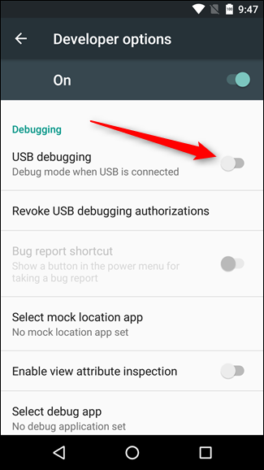
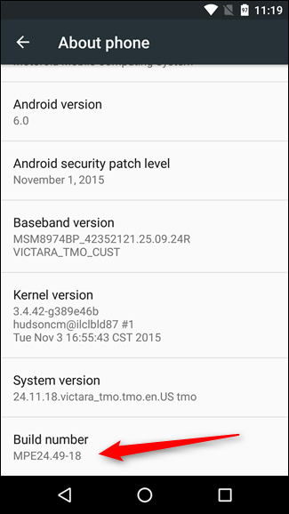
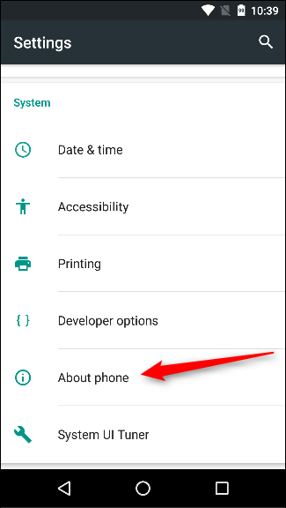
First time to on USB Debugging?
Developer options enable
Press 7X on build number
press 7x

Slide 98
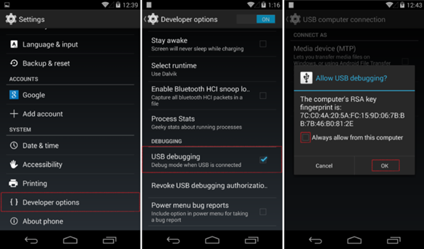
First time Allow USB debugging?

Slide 99
Ionic build

Slide 100
Create Android project/platform ionic capacitor add android
Run only once for each ionic project
To update Android project, execute
ionic build
npx cap copy

Slide 101
Copy to www to android project npx cap copy

Slide 102
To open project on Android Studio npx cap open android

Slide 103
Open in Android Studio

Slide 104
Codes & slides github.com/khirulnizam/ionic5

Slide 105


T07 Pilihan Selection : if…else, ngIf
Codes & slides
github.com/khirulnizam/ionic5

Slide 106
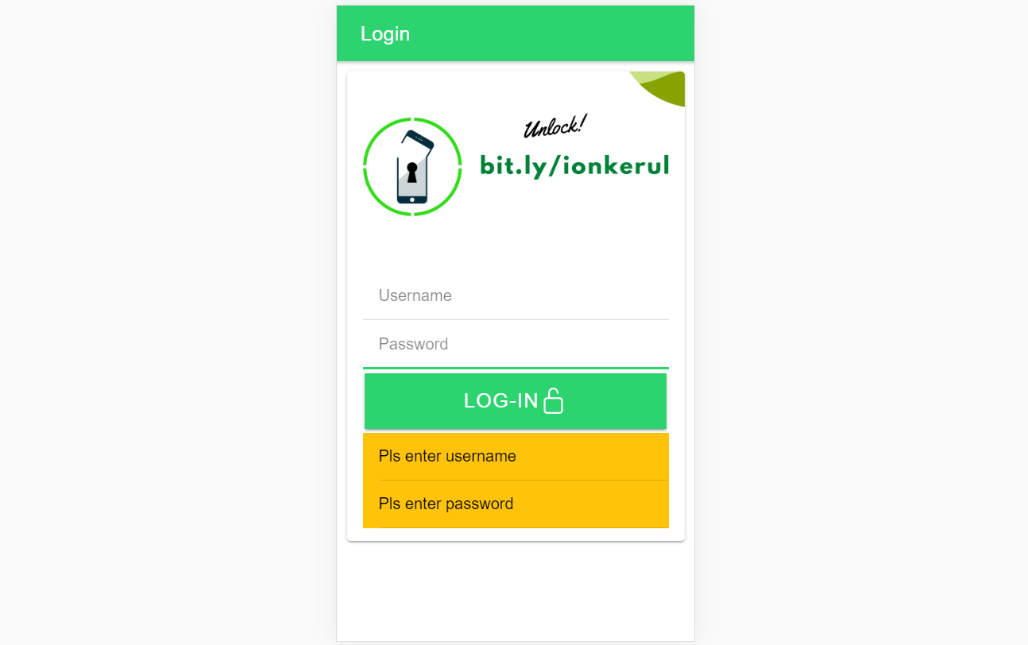
Output overview

Slide 107
Create a new page
ionic g page login
(selection exercise)

Slide 108
[(ngModel)]
Example:
IN TYPESCRIPT:
username:any;
password:any;
IN HTML:
<ion-input [(ngModel)]= “username”>
</ion-input>
<ion-input [(ngModel)]= “password”>
</ion-input>
[(ngModel)] USED IN HTML to capture what is typed into input to TypeScript

Slide 109
*ngIf used in HTML
Usually used for array iterations
Example:
IN HTML
<div *ngIf= “ username==null ”>
Pls enter username
</div>
<div *ngIf= “ password==null ”>
Pls enter password
</div>
*ngIf USED IN HTML

Slide 110
*ngIf … else used in HTML
<div *ngIf="gambar; else noImageYet">
<img src="{{gambar}}">
</div>
<ng-template #noImageYet>
<img src="./assets/noimagep.png">
</ng-template>
*ngIf … else USED IN HTML

Slide 111
IF...ELSE IF...ELSE AND *ngIFStatements
Usually used for selection and/or filtering
Example:
if(username== null){
alert(“Pls insert username”);
}
else if(password==null){
alert(“Pls insert password”);
}
else {
alert(“Welcome user”);
}
IF...ELSE IF..ELSE USED IN TYPESCRIPT IS EXACTLY THE SAME AS JAVASCRIPT

Slide 112
Output

Slide 113

T08 Ulangan Repetition : for, foreach, ngFor

Slide 114
Codes & slides github.com/khirulnizam/ionic5

Slide 115
Create a new page
ionic g page irepeat
(repetition exercise)

Slide 116
For Loop and *ngFor
Usually used for array iterations. Example:
negeri[0]= “Johor”;
negeri[1]= “Melaka”;
negeri[2]= “N. Sembilan”;
negeri[3]= “Selangor”;
for(var x=0;x<negeri.length;x++)
{
console.log(negeri[x]);
}
This will output in the console all the items in the array
FOR LOOP USED IN TYPESCRIPT

Slide 117
For Loop and *ngFor
Usually used for array iterations
Example:
IN TYPESCRIPT
negeri[0]= “Johor”;
negeri[1]= “Melaka”;
negeri[2]= “N. Sembilan”;
negeri[3]= “Selangor”;
IN HTML
<ion-item *ngFor= “let item of negeri”>
{{ item }}
</ion-item>
This will output all the negeris in HTML
*ngFor LOOP used in HTML

Slide 118

T09 Navigasi (navigation with parameters)

Slide 119
PARAMETERS
PAGE 1
(irepeat)
PAGE 2
(displayparams)
Nama: Kerul
Poskod: 43000
Negeri: Selangor
Nama: Kerul
Poskod: 43000
Negeri: Selangor
Nama: Kerul
Poskod: 43000
Negeri: Selangor

Slide 120
Navigation with Parameters
1. Using Router
TO SEND VALUES (CANNOT SEND OBJECTS)

Slide 121
2. Using Services
Navigation with Parameters
*TO SEND OBJECTS

Slide 122
Using ActivatedRoute
On app-routing.module.ts add param name, example /:id
Add /id when navigating
To get param
import {Router} from ‘@angular/router’
public route:Router
let the_id=this.route.snapshot.params.id

Slide 123
Using Services

Slide 124
USING SERVICES
HOME
SERVICES:
Functions
createUser(email, password)
{
…
}
loginUser(){
…
}
listUsers(){
…
}
DAFTAR
LOGIN
OTHER SERVICES

Slide 125
Using SERVICES
Services can be used globally
Can be used repeatedly
By different pages/other services

Slide 126
Generate a service
ionic g service service/data
Import Service and call from page ts

Slide 127


Slide 129


shareMasjid

Slide 130

& Firestore Auth

Slide 131


t10 Firebase (setup)

Slide 132

github.com/khirulnizam/ionic5 wasap.my/60129034614

Slide 133

Serverless option using Firebase
Serverless computing is a method of providing backend services on an as-used basis
A Serverless provider allows users to write and deploy code without the hassle of worrying about the underlying infrastructure
Scalable - the serverless vendor handles all of the scaling on demand
Simplified backend code
Quicker turnaround

Slide 134

JSON Concept
JSON: JavaScript Object Notation.
JSON is a lightweight data-interchange format
JSON format is text only, it can easily be sent to and from a server.

Slide 135
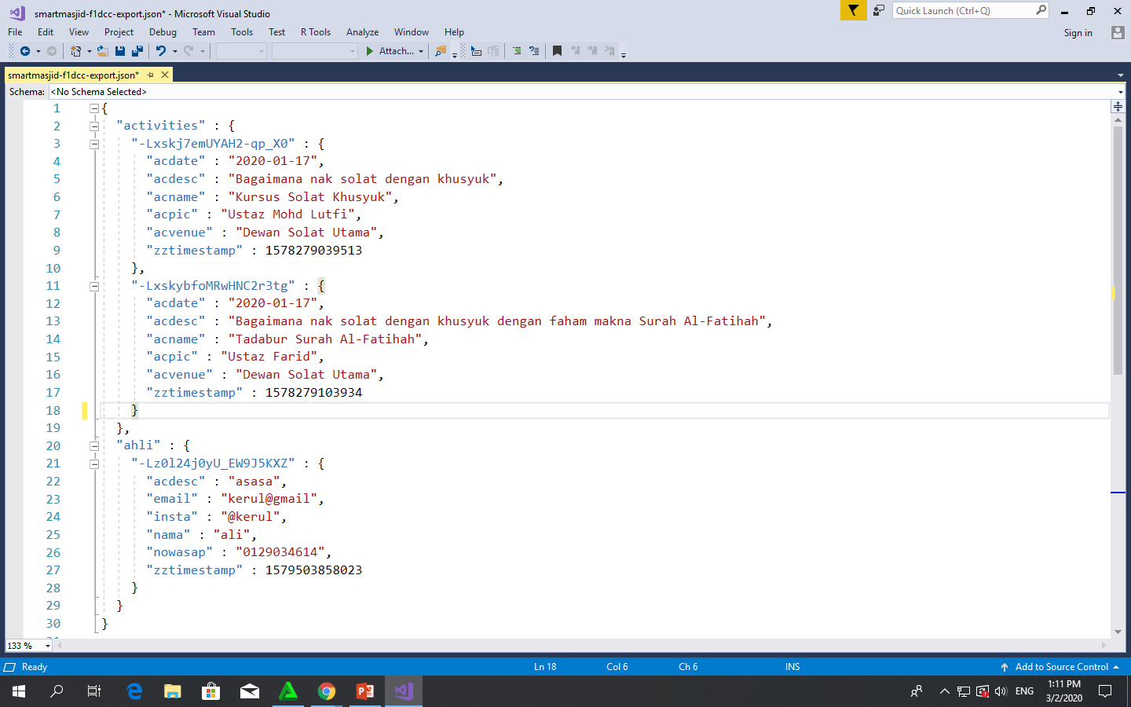
Play.google.com
JSON format example as applied in Firebase

Slide 136
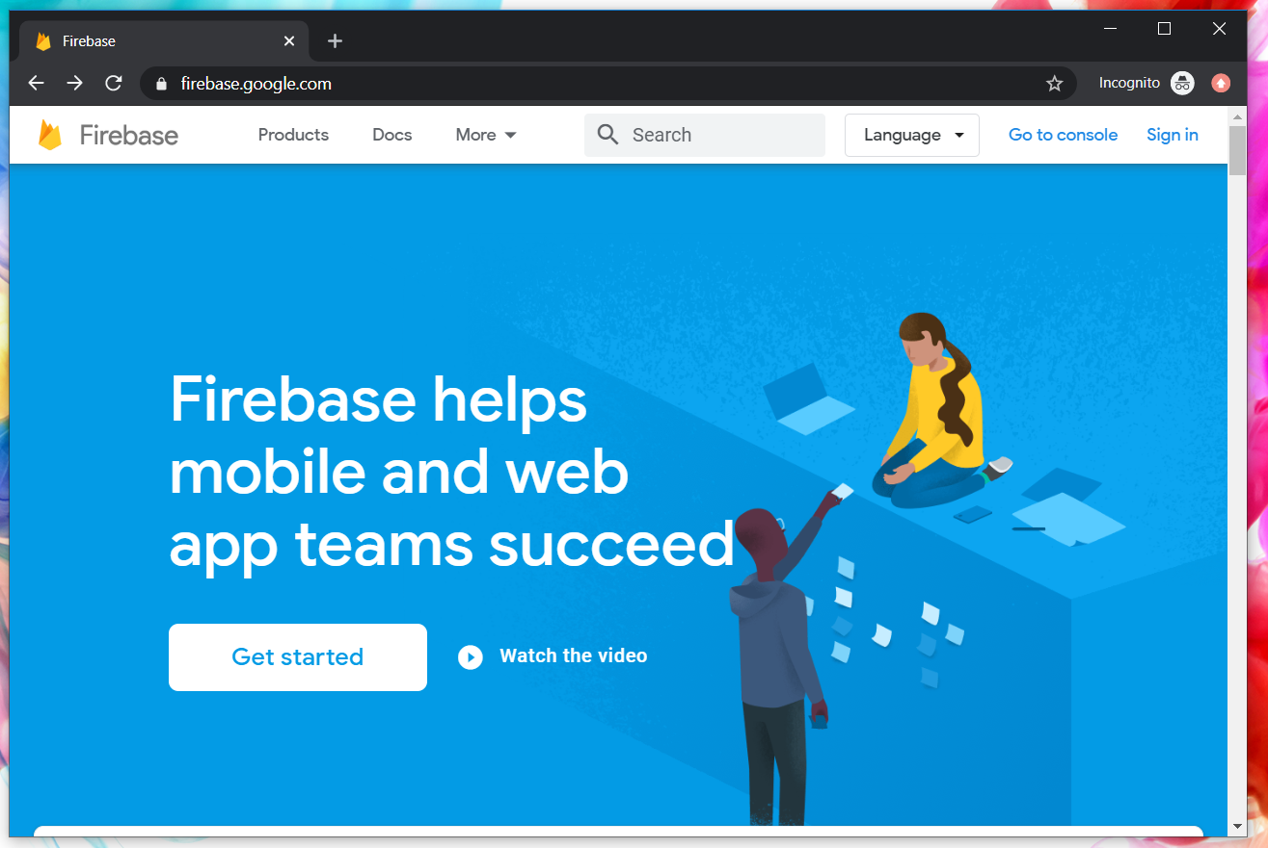
Google Firebase : Console
https://console.firebase.google.com/

Slide 137
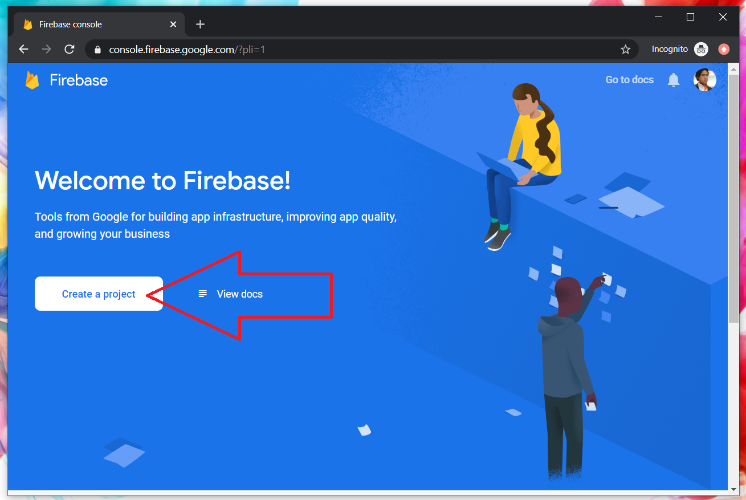
Google Firebase : Create new project

Slide 138
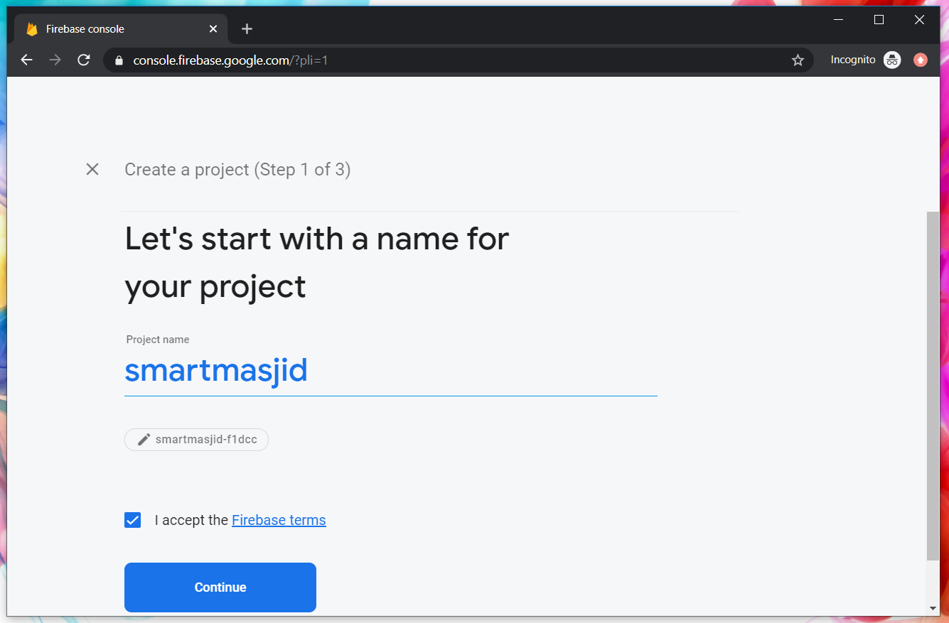
Google Firebase : Project name
sharefstm

Slide 139
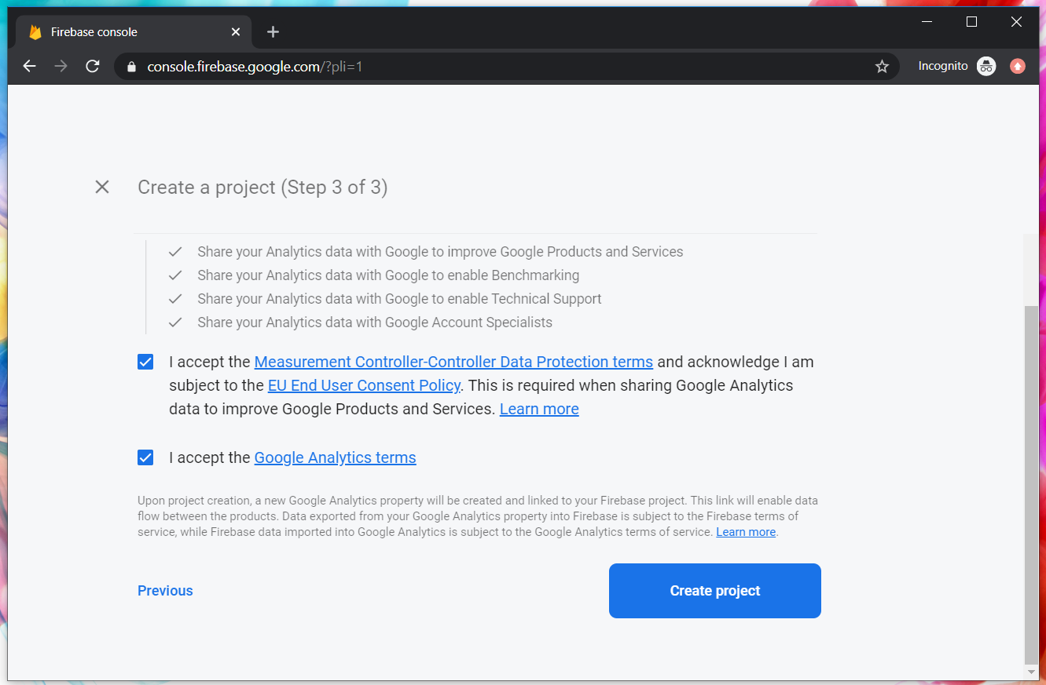
Google Firebase : Accept T&C

Slide 140
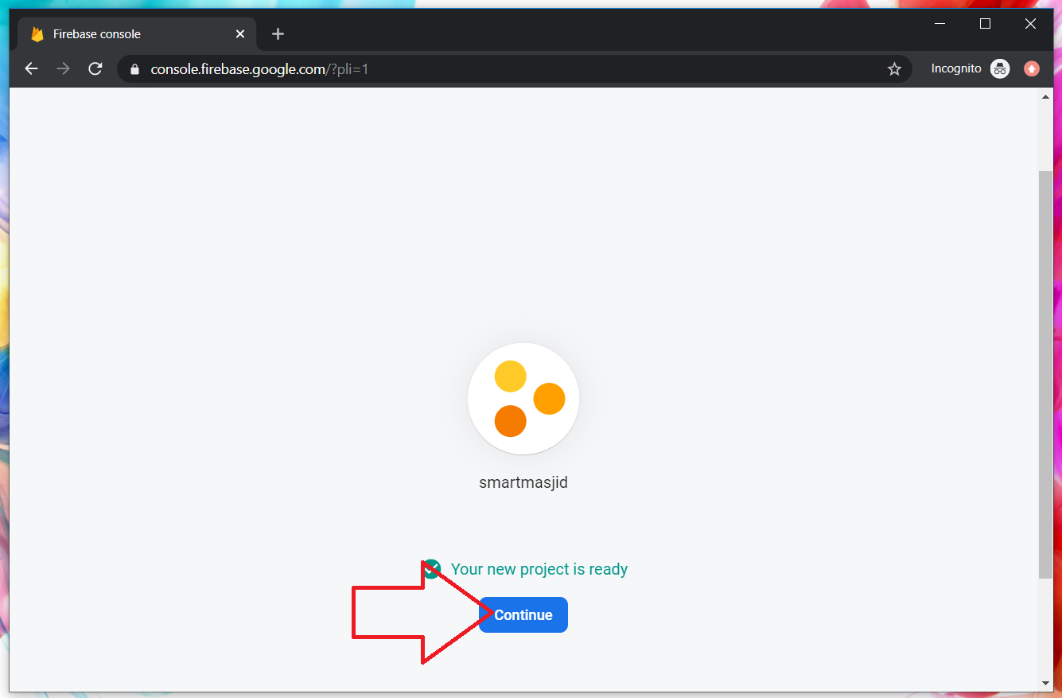
Google Firebase : Project ready and continue
makanapps

Slide 141
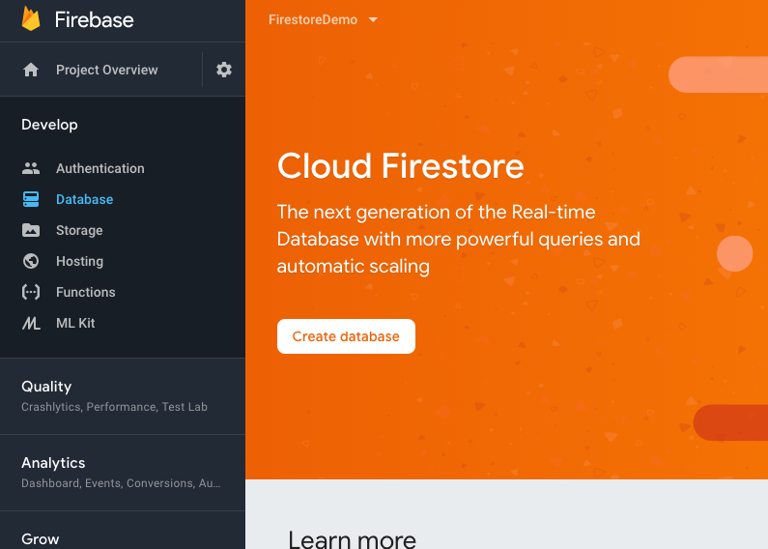
Google Firebase : Firestore database, automatic scaling

Slide 142
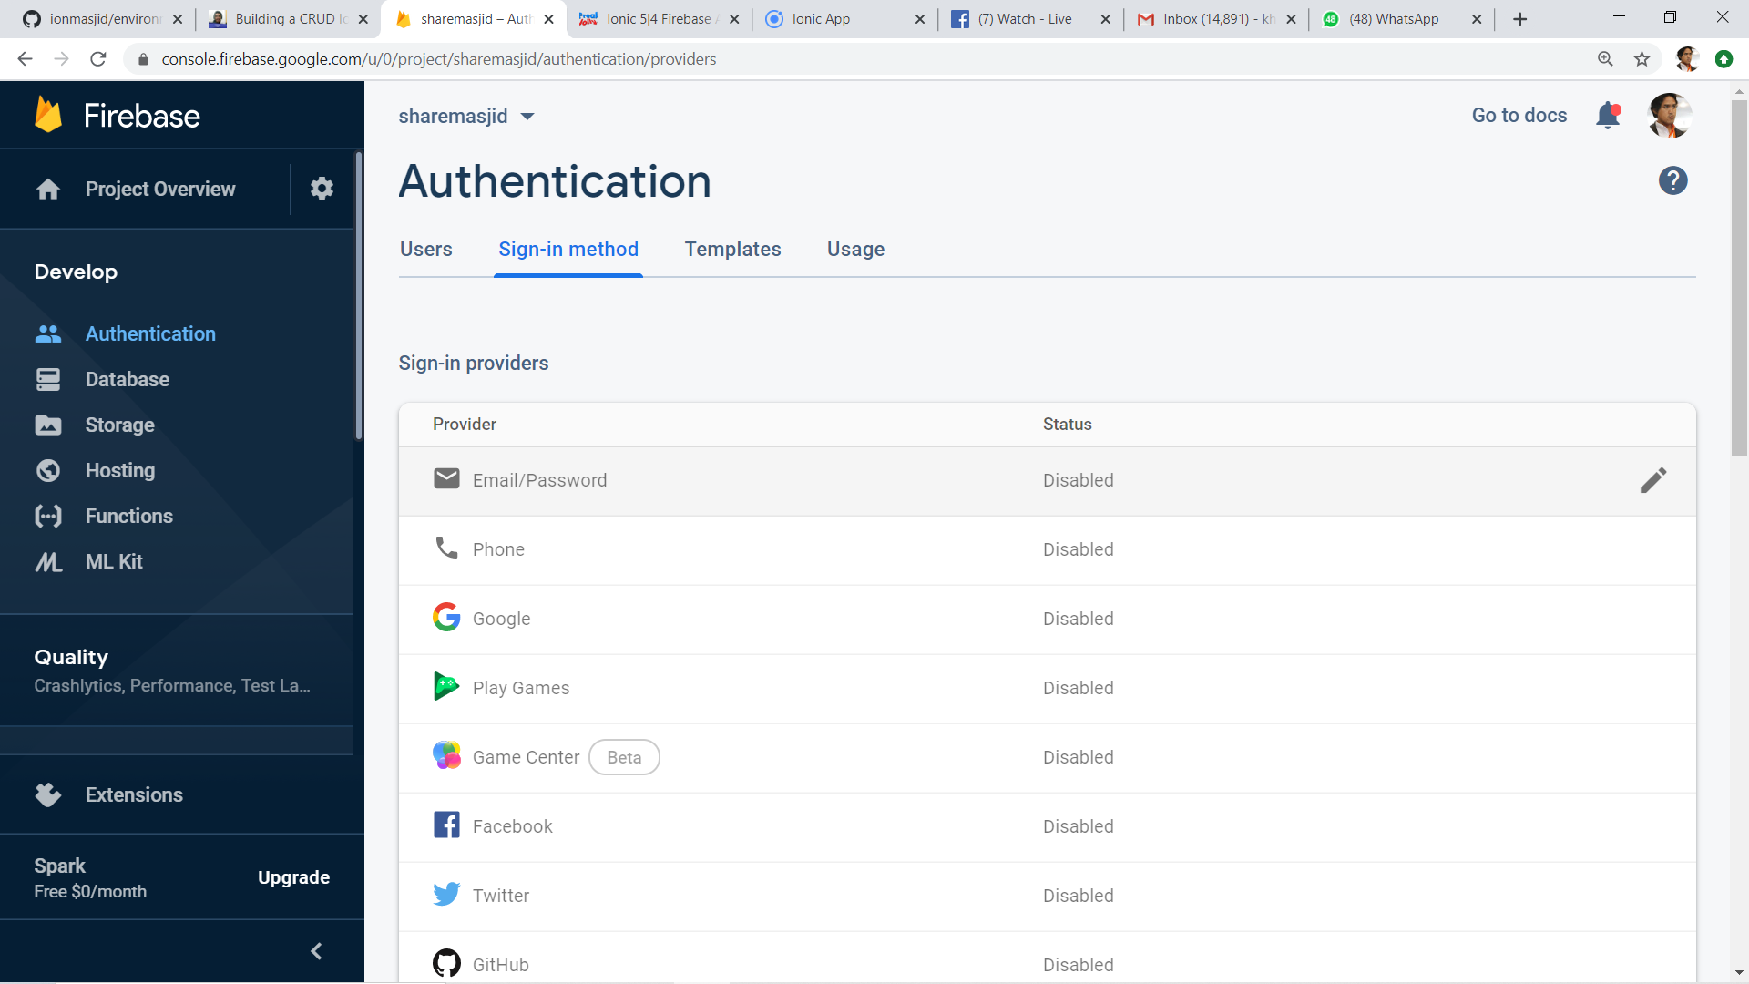
2
1
3

Slide 143
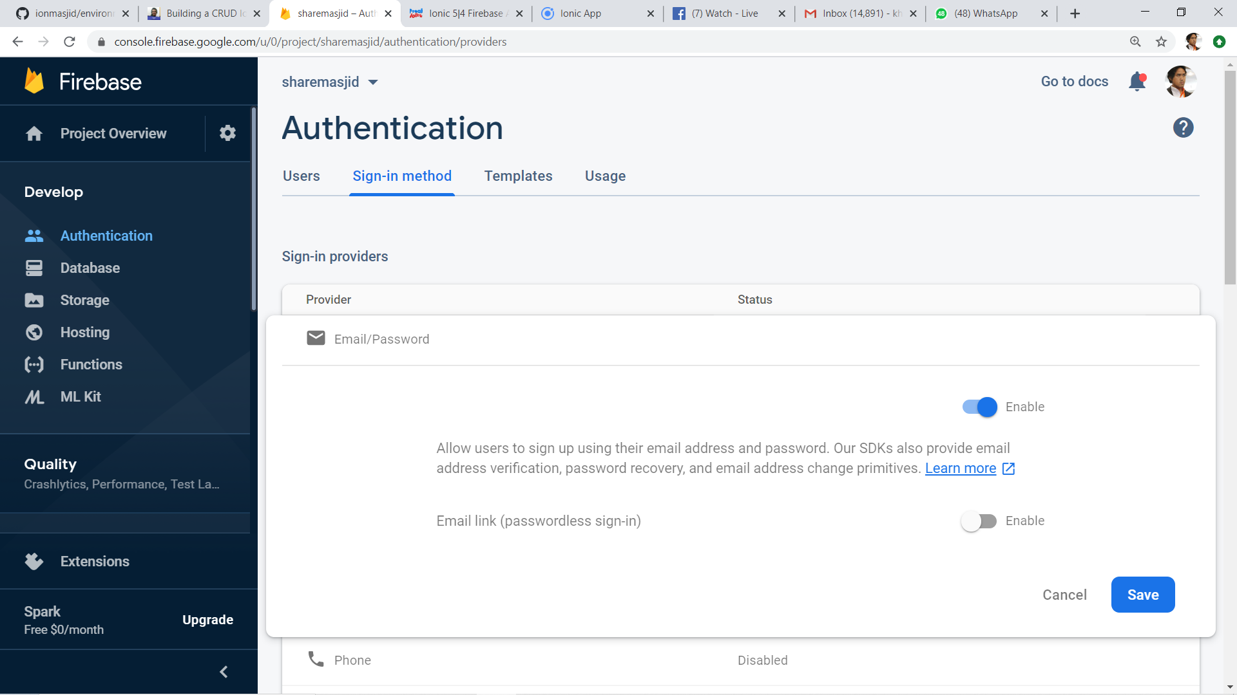
1
2

Slide 144

Google Firebase : Enable test mode

Slide 145

Google Firestore : add Firebase to app

Slide 146

Web Apps Firebase Configuration : Copy the highlighted

Slide 147

T11 Auth + Register
(daftar pengguna)

Slide 148

Create new Ionic project
ionic start sharefstm blank
Page 1: home

Slide 149

Filename src/app/home/home.page.html

Slide 150
Paste the Firebase configuration to environtment.ts
In environment.ts
…
export const environment : {
production: false,
firebaseConfig: {
apiKey: "AIzXXXXXXXXXXXXXXXWZMPN90HFrp4",
authDomain: "test-projeXXXXXXX.firebaseapp.com",
databaseURL: "https://test-projeXXXXXXX.firebaseio.com",
projectId: "test-projeXXXXXXX7",
storageBucket: "test-projeXXXXXXXX.appspot.com",
messagingSenderId: "446XXXXXX105"
}
};
…

Slide 151
Install AngularFirebase plugins
npm install firebase @angular/fire

Slide 152
Filename src/app/app.module.ts
//src/app/app.module.ts
…
//firebase & auth
import { AngularFireModule } from '@angular/fire';
import { AngularFireAuthModule } from '@angular/fire/auth';
import { environment } from '../environments/environment';
…
imports: [BrowserModule, IonicModule.forRoot(), AppRoutingModule,
//firebase & auth
AngularFireAuthModule,
AngularFireModule.initializeApp(environment.firebaseConfig),
…

Slide 153
Create globally accessible functions in folder services
ionic g service services/firebase
import { AngularFireAuth } from '@angular/fire/auth';
…
export class FirebaseService {
constructor(
private afAuth: AngularFireAuth
) { }
registerUser(email, password) {
return new Promise<any>((resolve, reject) => {
this.afAuth.createUserWithEmailAndPassword(email, password)
.then(
res => resolve(res),
err => reject(err))
})
}

Slide 154

Add another page
ionic g page daftar
Page 2: daftar

Slide 155

Filename src/app/daftar/daftar.page.html

Slide 156

Filename src/app/daftar/daftar.page.html

Slide 157

Filename src/app/daftar/daftar.page.ts

Slide 158

Filename src/app/daftar/daftar.page.ts

Slide 159


Slide 160
T12 Auth + Login
(pengesahan pengguna)

Slide 161
github.com/khirulnizam/ionic5 wasap.my/60129034614

Slide 162
Add globally accessible functions in folder services
ionic g service services/firebase
import { AngularFireAuth } from '@angular/fire/auth';
…
loginUser(email, password) { //function loginUser
return new Promise<any>((resolve, reject) => {
//authenticating with email & password
this.afAuth.signInWithEmailAndPassword(email, password)
.then(
res => resolve(res), //successful
err => reject(err)) //rejected
})
}//end loginUser
…

Slide 163

Add another page
ionic g page login
Page 3: login

Slide 164

Filename src/app/login/login.page.html

Slide 165

Filename src/app/login/login.page.html

Slide 166
Filename src/app/login/login.page.ts
…
cubalogin(email, password) {
this.fService.loginUser(this.email, this.password)
.then(res => {
console.log(res);
this.errorMessage = "";
//this.navCtrl.navigateForward('/dashboard');
}, err => {
this.errorMessage = err.message;
})
}//end cubalogin
…

Slide 167
github.com/khirulnizam/ionic5 wasap.my/60129034614

Slide 168




CRUDS

Slide 169

T13 Rekod Baharu
(insert new record)

Slide 170
github.com/khirulnizam/ionic5 wasap.my/60129034614

Slide 171
T14 Papar Senarai Rekod

Slide 172
github.com/khirulnizam/ionic5 wasap.my/60129034614

Slide 173
T15 Carian

Slide 174
github.com/khirulnizam/ionic5 wasap.my/60129034614

Slide 175
T16 Kemaskini
(update record)

Slide 176
github.com/khirulnizam/ionic5 wasap.my/60129034614

Slide 177
T17 Padam
(delete record)

Slide 178
SQLite
Ionic 5 Modals and SQLite Tutorial: Build a Product Manager App | Techiediaries
Ionic SQLite Tutorial - codesundar

Slide 179
JSON Ionic
Ionic 5 HTTP POST with Angular by Example | Techiediaries
Loading Remote JSON Data with HTTP in Ionic | joshmorony - Learn Ionic & Build Mobile Apps with Web Tech

Slide 180

Pengujian apps pada Android Emulator

Slide 181

Download Android Studio https://developer.android.com/studio

Slide 182

File -> New -> New Project

Slide 183

Package name

Slide 184

Tools -> AVD Manager

Slide 185

+ Create Virtual Device

Slide 186

Minimal resolution device

Slide 187

Choose available Android system image

Slide 188

If system image not yet available
Download Android
system image for
1.5GB! (estimation)

Slide 189

AVD name
Click Finish

Slide 190

Run Android Virtual Device

Slide 191

Run
Shift+F10

Slide 192

Apps is
Running
On AVD

Slide 193
Slides & materials github.com/khirulnizam/ionic5

Slide 194


Muatnaik Apps ke
Google Playstore
Fblive FSTM KUIS
11pg 6Nov 2020 (Jumaat)

Slide 195

←App ID

Slide 196

Play.google.com
Register for a developer ID
USD25 for life.
Another consideration: you need to pay through Google Wallet, using a credit card. https://play.google.com/apps/publish/

Slide 197
Playstore Graphic Materials
high-res icon. (size 512px x 512px)
Featured graphic. (size 1024px x 500px)
at least 2 non-Android TV screenshots. (2 screenshot images. Min length for any side: 320px)

Slide 198

Samples of graphic materials & signed bundle/APK

Slide 199
Graphic materials github.com/khirulnizam/ionic5

Slide 200



Slide 201


bit.ly/m-mathurat
(ionic)

Slide 202
https://ionicframework.com/docs/cli/commands/cordova-resources
Graphic materials
resources/icon.png (with size 1024x1024)
resources/splash.png (with size 2732x2732)

Slide 203

https://ionicframework.com/docs/cli/commands/cordova-resources
Graphic materials
resources/icon.png (with size 1024x1024)
resources/splash.png (with size 2732x2732)
(create folder resources)
splash.png
(2732x2732px)
icon.png (1024x1024px)

Slide 204
https://ionicframework.com/docs/cli/commands/cordova-resources
Commands - CLI
ionic cordova resources

Slide 205

Ionic cordova resources
(created after ionic cordova resources)

Slide 206
In file package.json add
"scripts": {
…
"resources":"cordova-res --skip-config --copy",
…
}

Slide 207
ionic capacitor add android
ionic build
npm install jetifier
npx jetifier
npx cap sync android
npx cap open android

Slide 208


Build, copy and open in Android Studioclz
ionic capacitor add android (sekiranya belum)
ionic build
npx cap sync android
npm install capacitor-resources -g
cordova-res --skip-config --copy
npx cap open android
Run apps in Android Studio
cordova-res to copy icon/splash from resources to Android project res folder

Slide 209



Kursus Perisian Pejabat
FPTT UTEM (online)
30 Dis 2020
Pn Mahani Ma’mum

